Slide 1
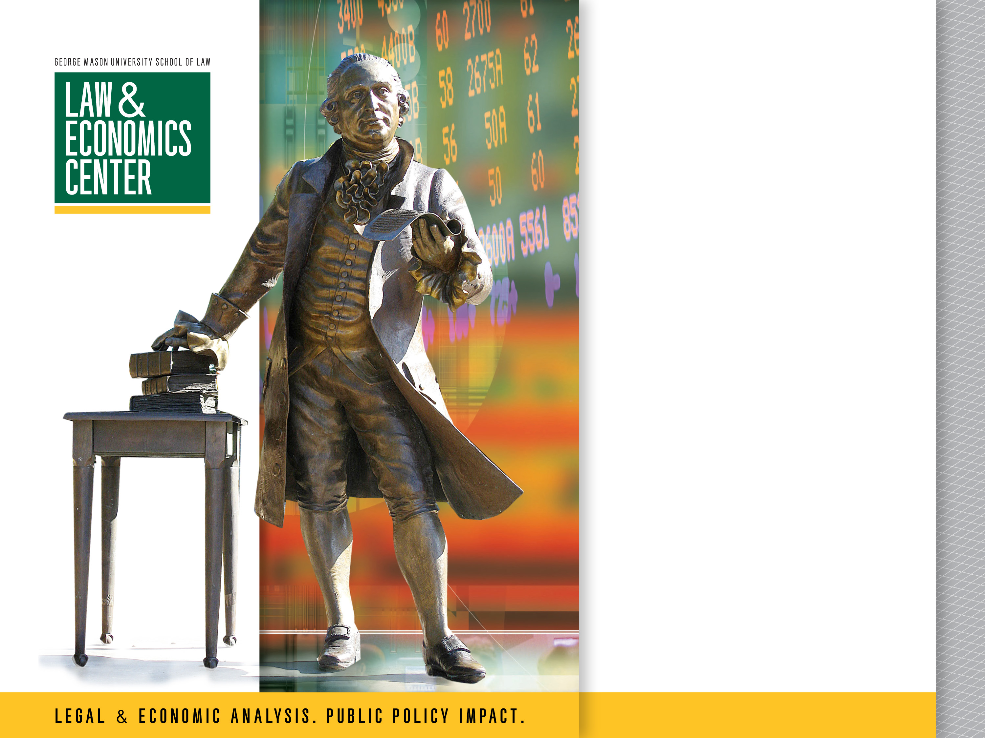
Economics of Payment Cards and Regulation Under EFTA and TILA
Presented by
Todd J. Zywicki GMU Foundation Professor of Law

Slide 2
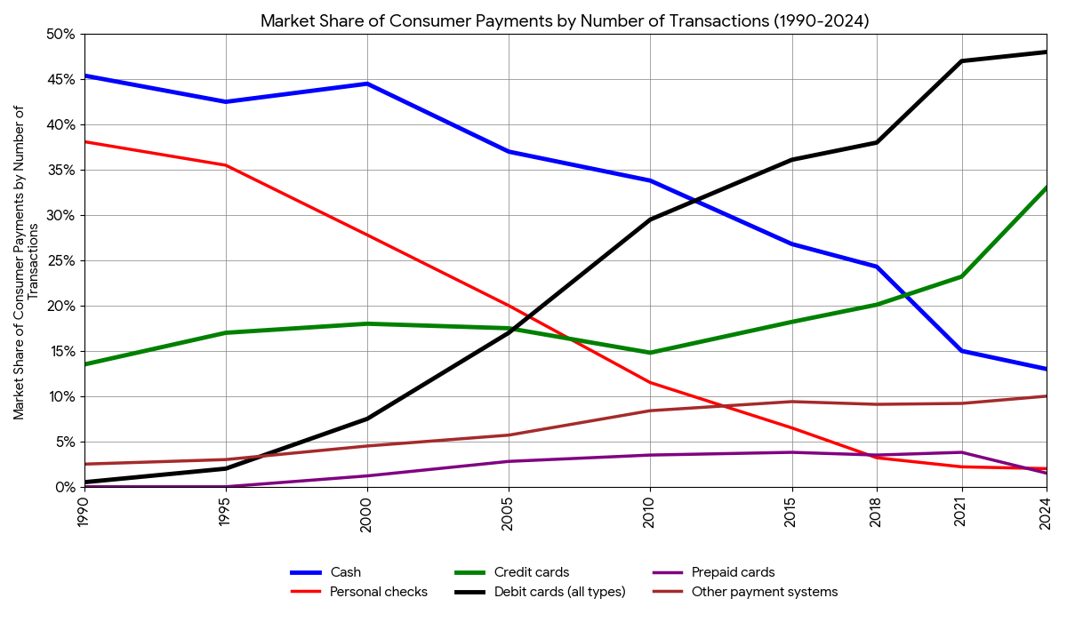
Market Share of Consumer Payments (# Transactions)

Slide 3
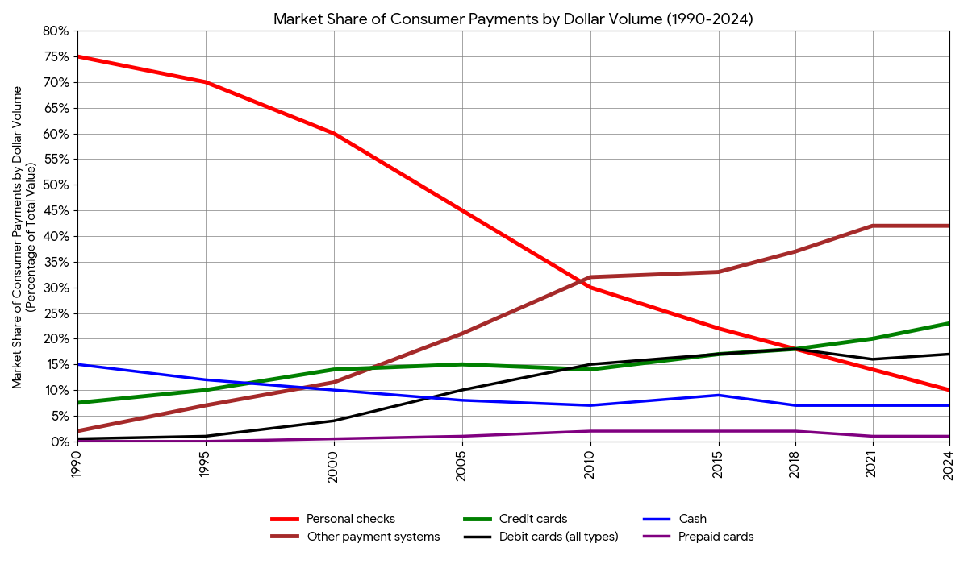
Market Share Consumer Payments ($ Value)
Note ACH: Large payments such as Mortgage, Car, Rent now ACH
Credit Cards > Debit

Slide 4
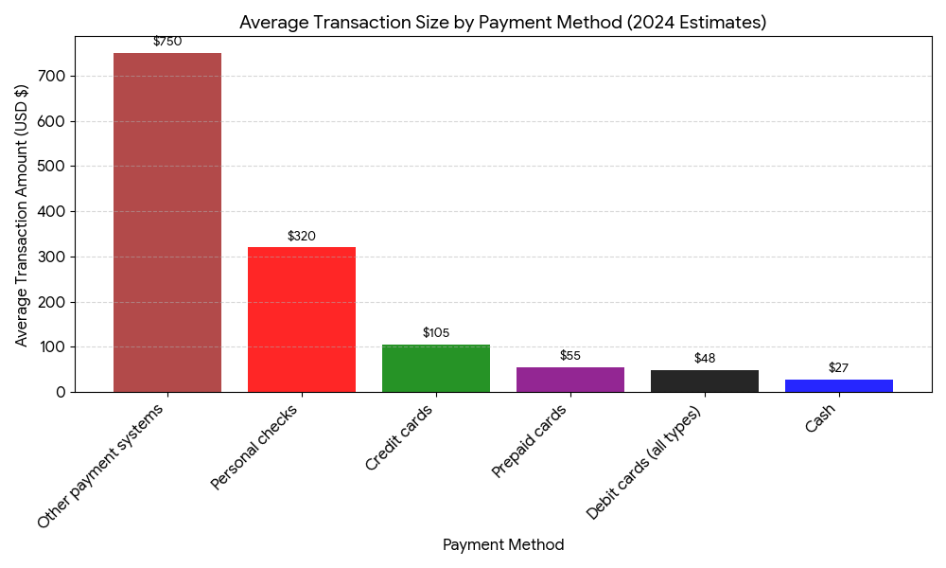
Average Transaction Size by Payment Method (2024)

Slide 5
Types of Payments
Debit: EFTA and Reg E
Two-Message “Signature” Debit: Uses credit card rails
Authorization and clearance are separate steps
Visa and MC
Single-Message PIN Debit:
Authorization and clearance simultaneous
Pulse, Star, etc.
ACH: Governed by EFTA and Reg E
Credit Cards
Checks: Governed by UCC Article 3 and Article 4
Peer-to-Peer: Still have to have a bank account

Slide 6
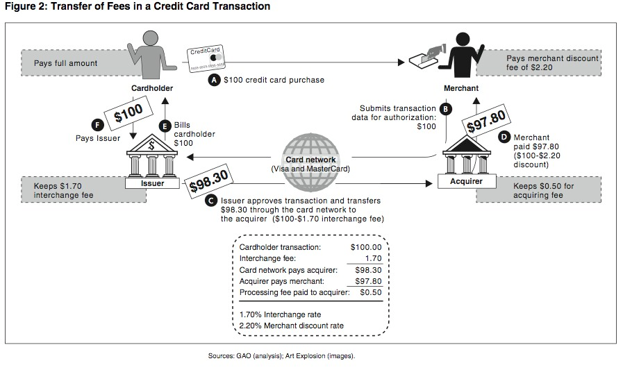
Four-Party System (or Five-Party)

Slide 7
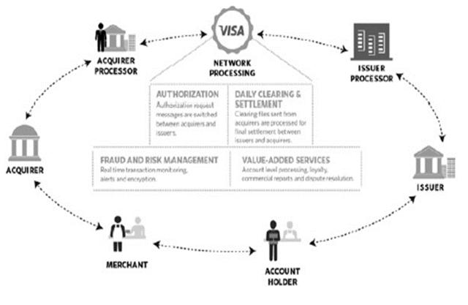
Role of the Network (Visa, MC)

Slide 8
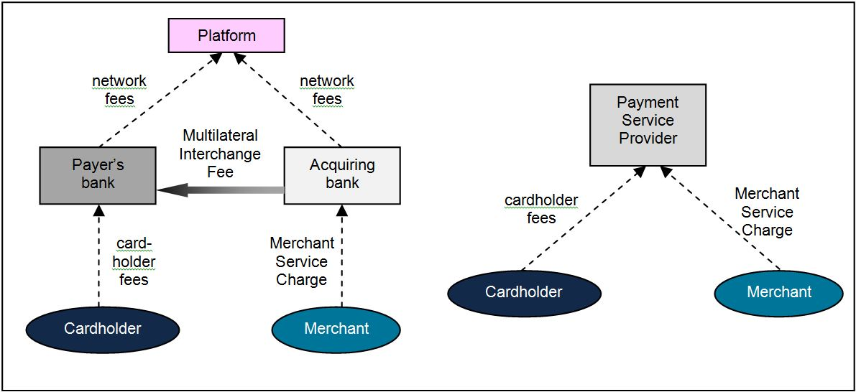
Three-Party System (AmEx, Diner’s, Discover/Cap One)

Slide 9
Consumer Benefits of Payment Cards
Liquidity: sales, emergencies
Fraud/Loss Protection
Household Budgeting
E-Commerce
Speed at checkout
Flexibility
Ubiquitous acceptance
Credit Cards: More choice and competition

Slide 10
Benefits to Merchants of Payment Cards
Consumer liquidity: sales
Speed
E-Commerce
Small business can compete with big retailers
Cost of cash:
Employee handling time, theft, and errors: airlines and metro
Maintaining cash: safes, armored cars
Estimated 9.1% of revenue
Cost of checks:
Slow
Bounce risk
Travel
Credit (covered later in the semester)

Slide 11
Social Benefits
Estimated that can save at least 1% of GDP by switching to electronic payments
Tax evasion and criminal behavior
Public health: Covid
Speed/efficiency of payments

Slide 12
Interchange fees and fiscalisation
Use of electronic payments and the shadow economy in Europe
Cash is difficult to trace and anonymous and so facilitates the underreporting of sales
Countries with large unbanked populations tend to have big shadow economies
Cash is a key enabler of the shadow economy
Average # of transactions/ inhabitant/year
300
Correlation: 0.56
250
200
150
100
50
0
0
10%
20%
30%
40%
50%
60%
SE % of GDP

Slide 13
Economics Of Interchange Fees
Two-Sided Markets: Jean Tirole
Platform balances two sides
Lower cost for consumers encourages card ownership, higher cost for merchants discourages card acceptance
Pricing is Different
Getting prices right difficult: technology, tax evasion, labor costs, etc.

Slide 14
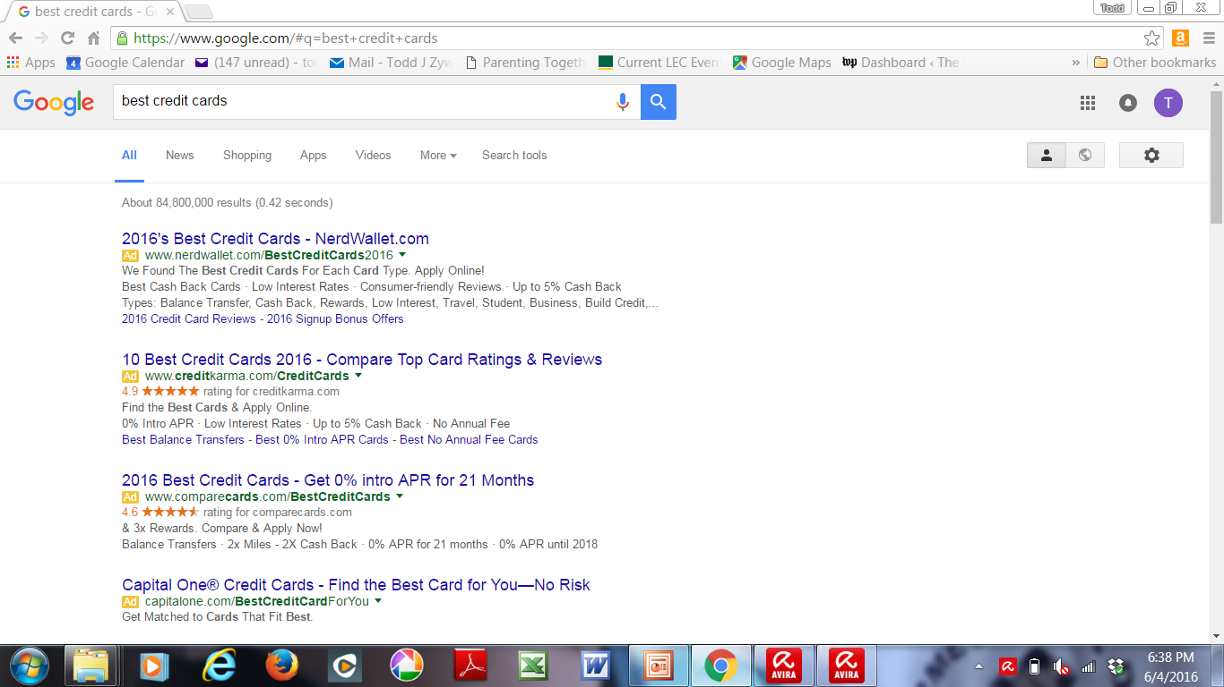
Search Engine

Slide 15
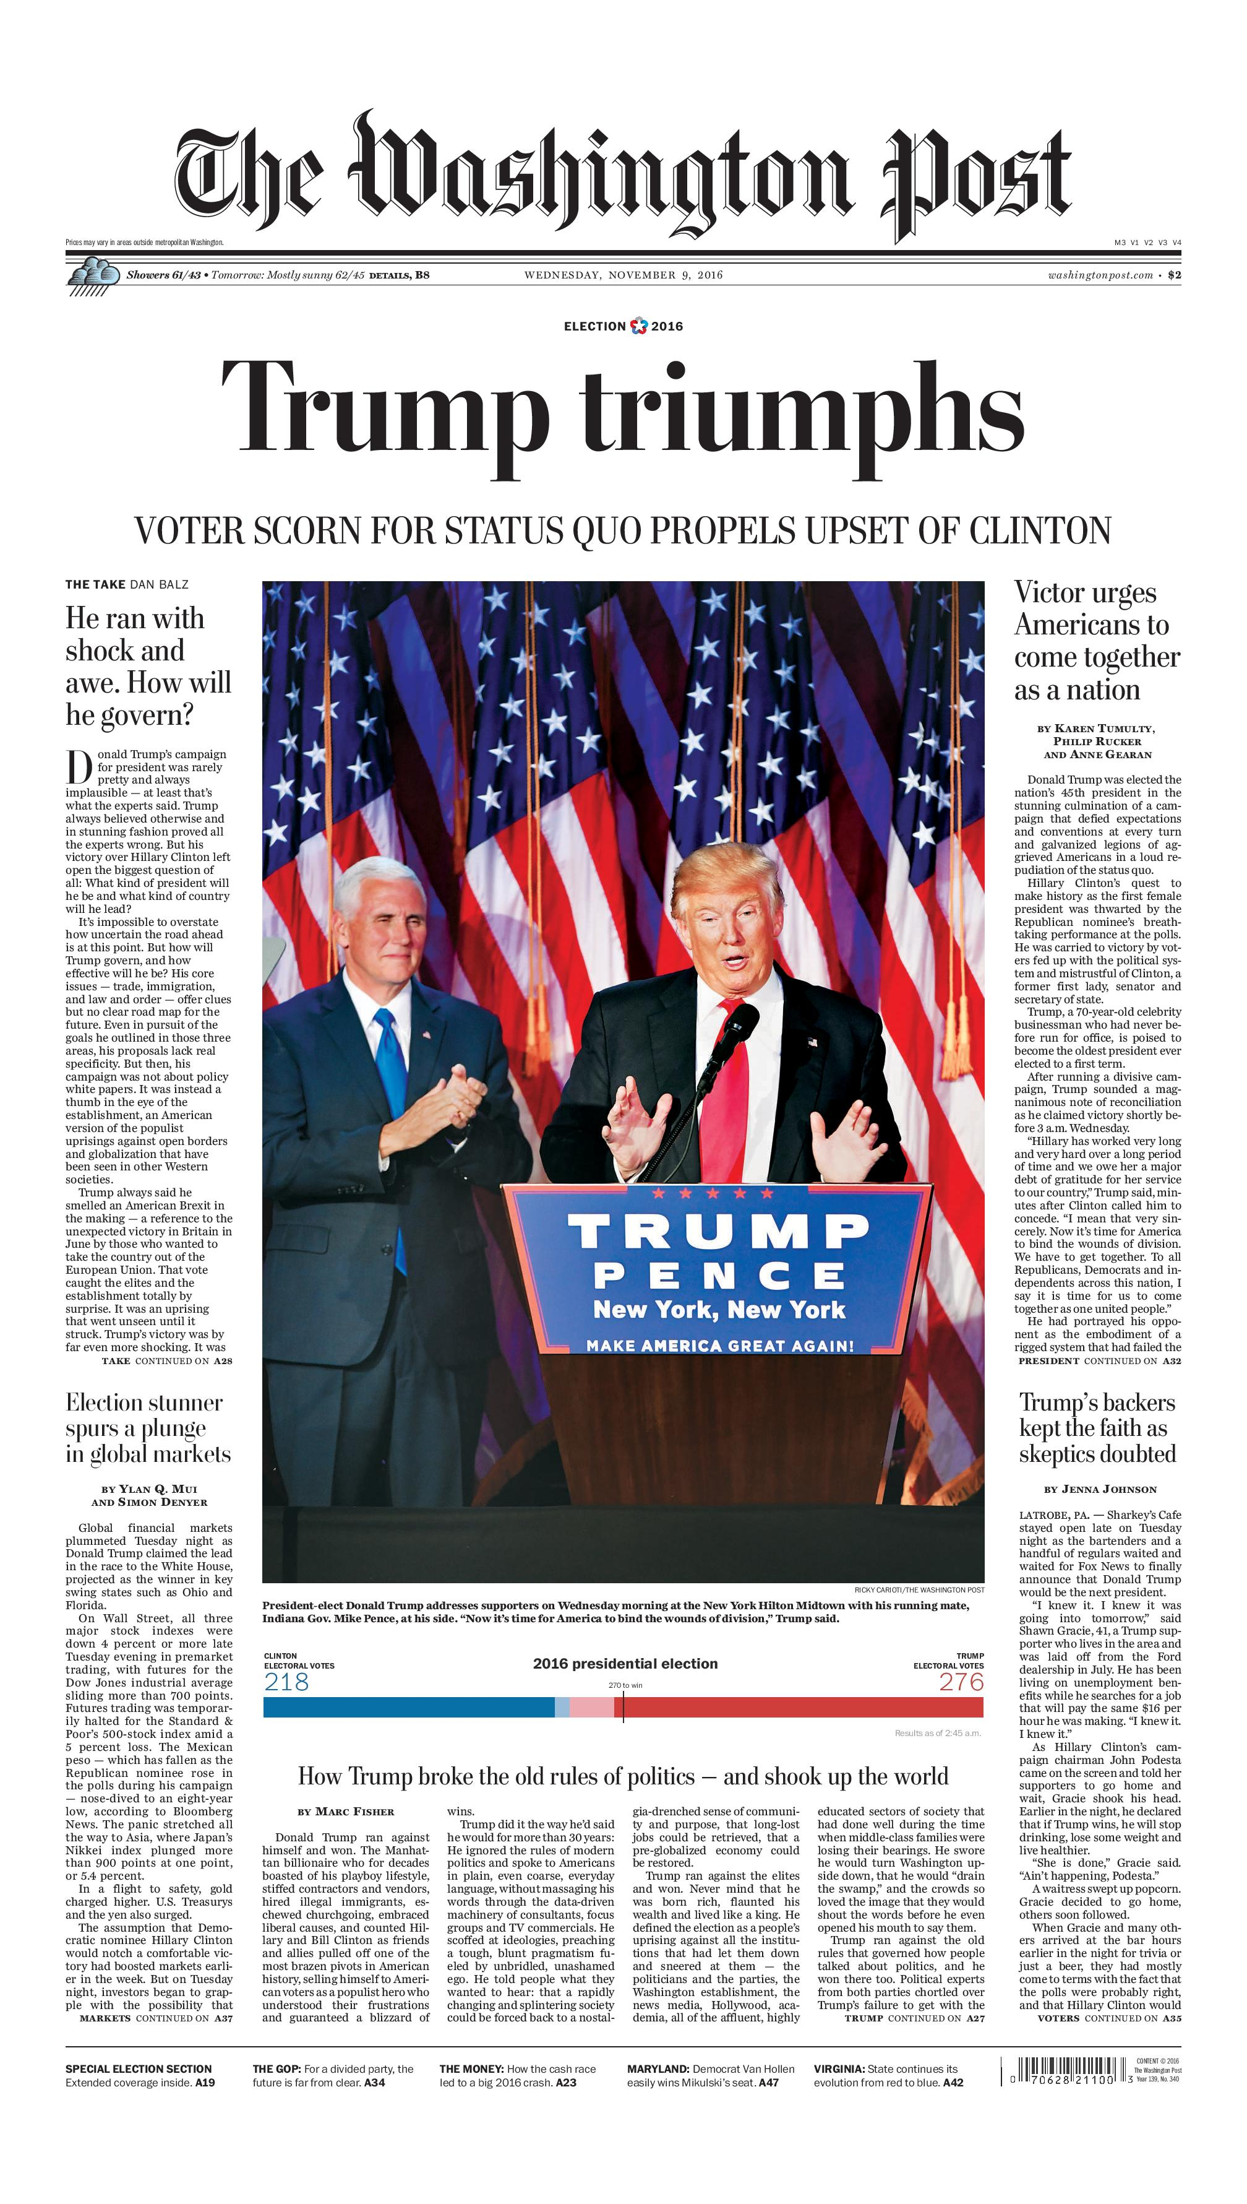
Newspaper

Slide 16
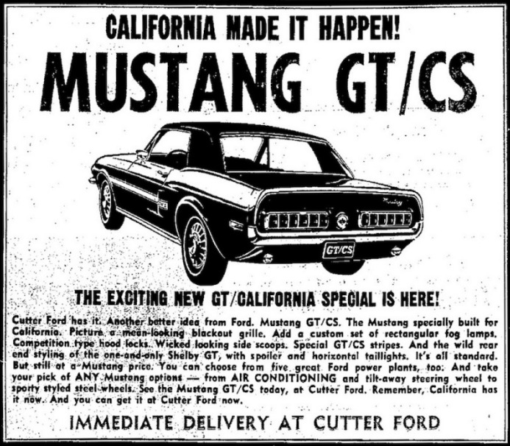
Newspaper: Reality

Slide 17
Interchange Fees: Pricing
Payments are Coasian: Costs only if both sides play, “It takes two to transact”
Price does NOT equal marginal cost: Price can be zero or negative even
More inelastic side of the market tends to bear the cost: Advertisers subsidize readers and search engines
But parties will only continue to participate if they still get benefits > costs
Prices of other payments subsidized by taxpayers (cash) or consumers (checks)
Cross-subsidies among consumers common: those who buy at the stand subsidize those who subscribe

Slide 18
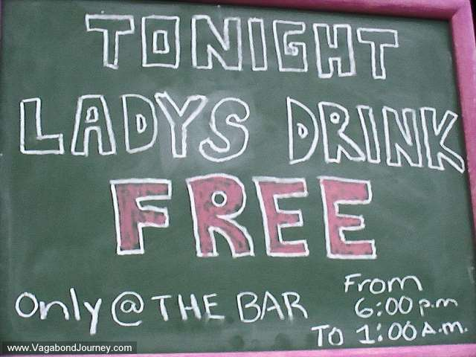
Zero or Negative Price

Slide 19
Arguments for Regulation of Interchange Fees
Efficiency: “Too Much” competition and prices “too low” for consumers, i.e., rewards are bad
Yet merchants subsidize too: Target Red Card
“Monopoly” power: “Too little” competition and prices are “too high” for merchants
But would more competition lead to higher or lower rates
“Fairness”

Slide 20
Monopoly/Duopoly?
Durbin: “The debit interchange system is not a properly functioning market. For years, card-issuing banks like Chase have agreed to let the Visa and MasterCard duopoly fix the interchange fee rates that banks receive from merchants each time a debit card is swiped. The banks get the fees but they do not set the fees. This system of price-fixing by Visa and MasterCard on behalf of thousands of banks has gone entirely unregulated.”
“Because Visa and MasterCard have enormous market power and control around 80 percent of the debit cards in consumers’ wallets, merchants cannot realistically say no to accepting Visa and MasterCard and have no leverage to negotiate fee rates with them. ”

Slide 21
Ohio v. Amex (2018)
Competition in two-sided market

Slide 22
“Fairness”: Regressive Subsidy
Retail Subsidies Common: Free parking, Free tellers, Savings Accounts
Depends on many assumptions:
Pass-through
Shop at same stores
Number of low income with cards/rewards cards
How large? (Boston Fed)
“After taking into account rewards, high-income consumers receive $8.9 billion ($413 per household), whereas low-income consumers receive $1.4 billion ($15 per household) annually.”
Is a smaller net benefit “regressive”?

Slide 23
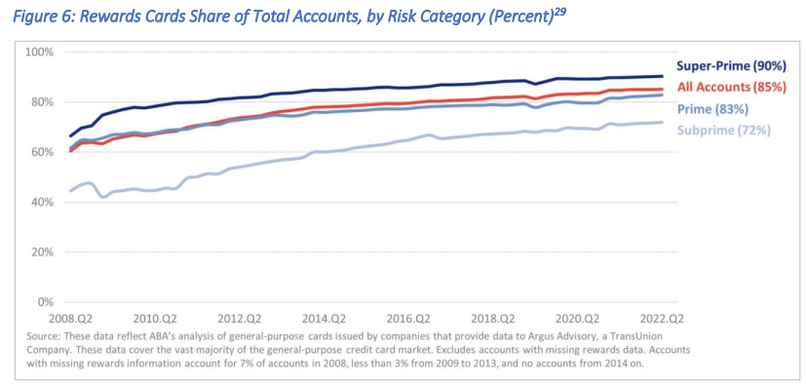
Rewards Cards by Share of Accounts

Slide 24
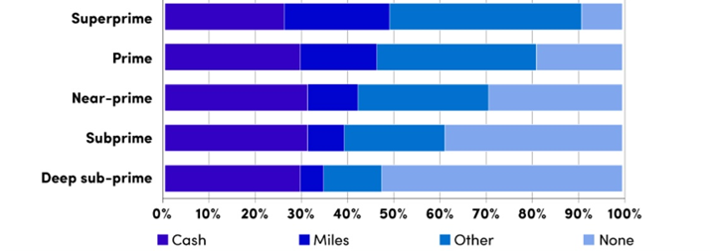
Purchase Volume by Credit Tier and Reward Type

Slide 25
Unintended Consequences of “Fairness”
As discussed below in US, capping interchange fees has led to:
Higher bank fees for low-income consumers: Monthly fees of $10-$20 or more per month ($120) versus $8 to $21 savings in retail prices per year
Loss of bank accounts
Reliance on high cost alternatives (prepaid, pawn)
Elimination of debit card rewards (high-income switched to credit cards)

Slide 26
Goals of Regulating Interchange Fees
Increase cost and reduce benefits of using cards
Reduce card usage
Reduce retail prices

Slide 27
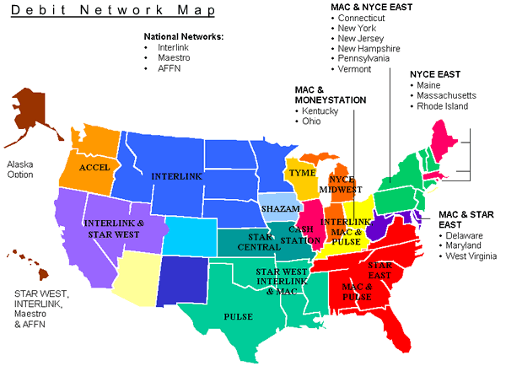
Debit Network Map

Slide 28
Durbin Amendment: 15 U.S.C. § 1693o-2
The Durbin Amendment has two key parts.
Part I: Regulation of debit interchange fees.
Debit card fee caps: “incremental costs”
Applies to Banks > $10 bill assets
Part II: Regulation of payment card network rules.
Debit card routing requirements: “Two unaffiliated networks”
1 Signature and 1 PIN network enabled
Cannot both be the same (i.e., Visa and Interlink)
Discounts to encourage use of particular payment systems: “steering "Can set Credit card minimum purchase amount ($10) (credit only, not debit)
No small bank exemption

Slide 29
Federal Reserve Rulemaking
Effective: October 1, 2011
Permits: $0.21 plus 0.5% of transaction value (5 basis points) plus $0.01 for fraud protection
Excludes: capital and other non-transactional costs
Cut average interchange fee for covered banks from $0.50 to $0.24 per transaction (52%)
Interchange fee for exempt banks (under $10 billion) not subject to cap

Slide 30
The Simple Economics of Interchange Fees
Costs of payment card system have to be paid by some combination of:
merchants (those who accept cards);
banks (those who issue cards); and
their respective customers.
Estimated loss to banks of approximately $6.6 to $8.6 billion as a result of Durbin Amendment
Banks needed to recoup those losses …

Slide 31
Effects of Durbin Amendment
Intended Effects: Lower Interchange Fees
Unintended Effects:
Term Repricing
Product Substitution
Rationing
Dynamic Effects
Unintended Effect: Regulatory Arbitrage

Slide 32
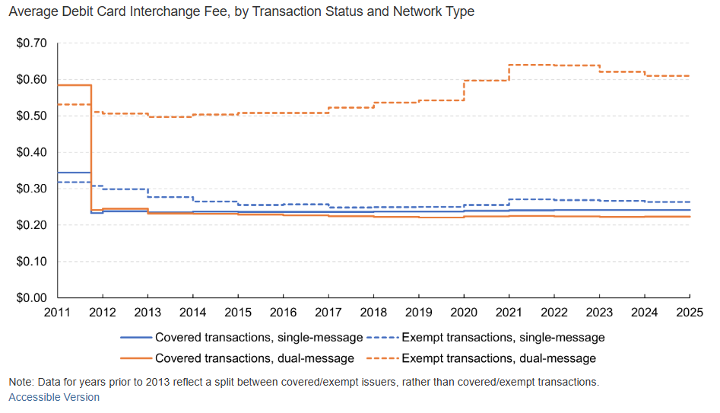
Intended Effect: Average Interchange

Slide 33
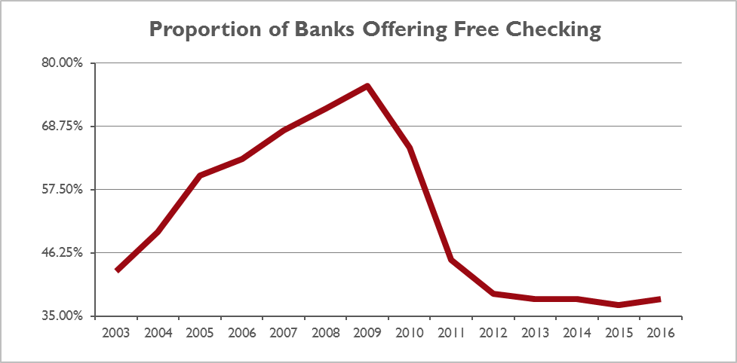
Effects on Consumers

Slide 34
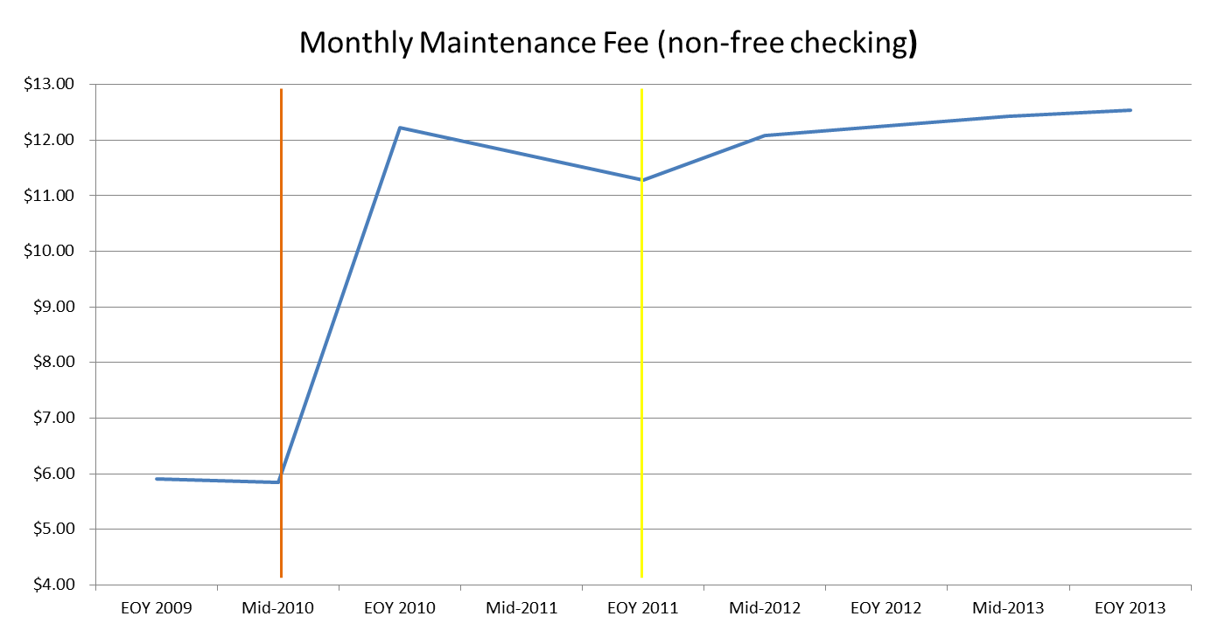
Effect on Fees

Slide 35
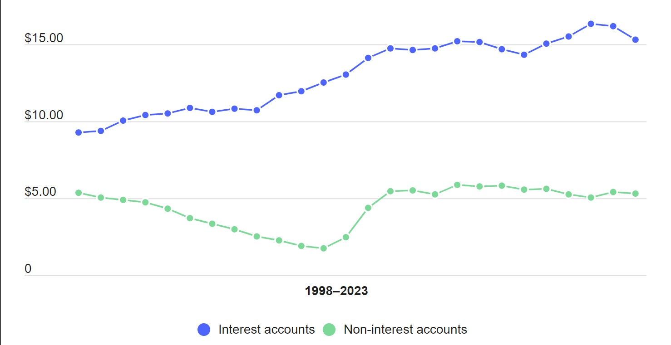
Bank Fees
2009

Slide 36
Average minimum holding needed to avoid fees (non-interest accounts)

Slide 37
Free Accounts: Covered v. Exempt Banks

Slide 38
Effect on Poor
Increased fees helped drive consumers out of mainstream banking system
Over 1 million increase in unbanked (10%) ’09-’11
Mostly lower-income consumers
Face higher cost of cheque cashing
Higher cost of loans (payday lenders, pawn shops)
Increased use of prepaid cards
Higher-Income switched to credit: Still get rewards
Debit card rewards reduced or eliminated

Slide 39
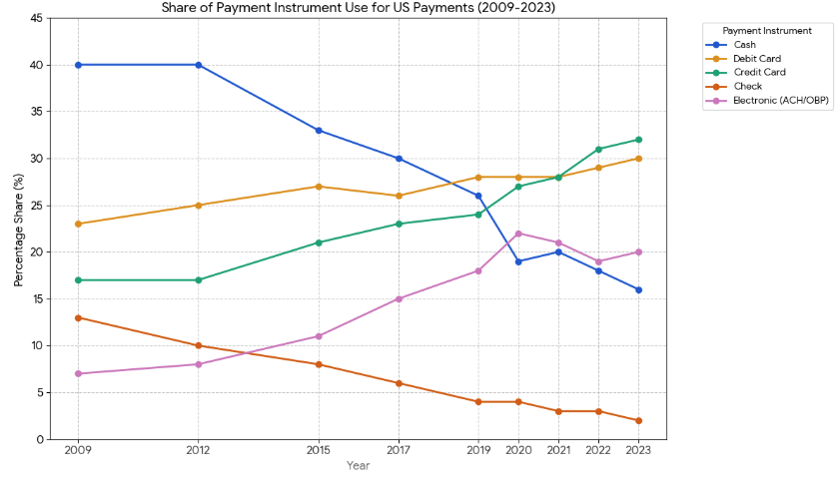
Effects of Durbin on Payment Choice
Rapid Credit growth mainly for transactional use

Slide 40
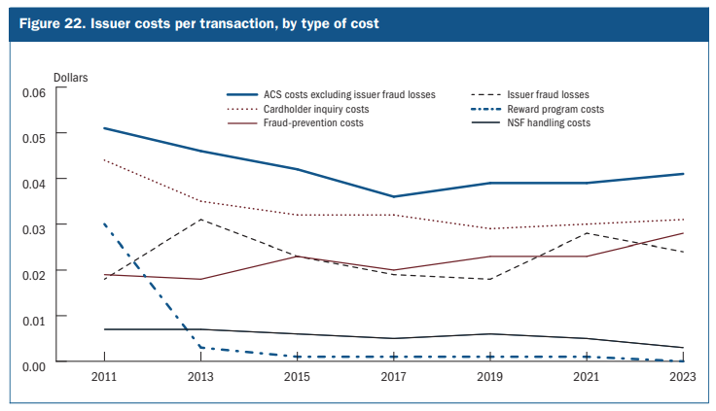
Term Repricing: Debit Cards Eliminate Rewards

Slide 41
Kay, Manuszak, and Vojtech (2018)
28% decrease interchange revenue: $4.1-$6.5 billion
90% of annual revenue loss recouped through higher bank fees
Deposit fees 15% higher than would have been otherwise
Few lost customers because of high switch costs ($176-$304/account)
“The Durbin Amendment was intended to generate benefits for consumers through lower transaction costs for merchants and correspondingly lower retail prices. In doing so, the amendment presumably intended to reduce bank interchange income without harming bank customers. However, we find that almost all of the burden of reduced interchange fees was borne by bank customers through higher account fees.”

Slide 42
Manuszak & Wozniak (2017, Federal Reserve)
Absent Durbin 65% of accounts would be free checking, with Durbin only 30%
Raised cost of non-free account by 17%-20%
The average minimum balance to avoid a monthly fee increased by over $400 (or 50 percent) for noninterest checking accounts, and by nearly $1,700 (or 55 percent) for interest checking accounts
Provided competitive cover for smaller banks to raise costs
Mark Manuszak and Krzysztof Wozniak

Slide 43
Mukharlyamov & Sarin (2019): Bank Customers
Durbin reduced annual interchange revenue by >25% for covered
What Happened?

Slide 44
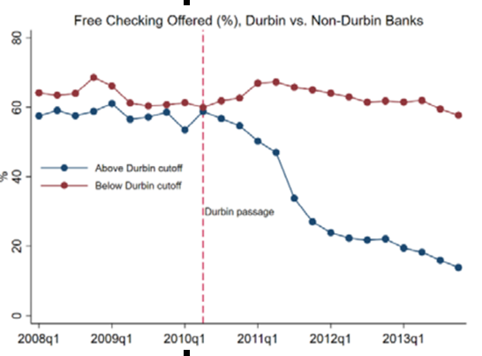
Free Checking: 60% to 20% (M&S)

Slide 45
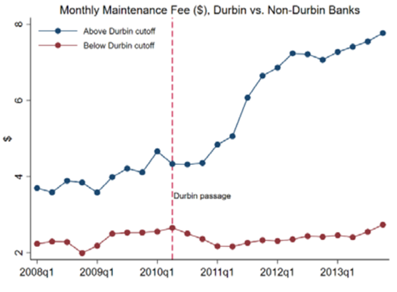
Monthly Maintenance Fee: $4.44 to $7.34 (M&S)

Slide 46
M&S (2019)
“Over 70% of consumers in the lowest income quintile ($22,500 or less) fall below the average post-Durbin average account minimum required to avoid a monthly maintenance fee ($1,400). Only 5 percent of consumers in the highest income quintile (household income of $157,00 or more) pay those fees.”

Slide 47
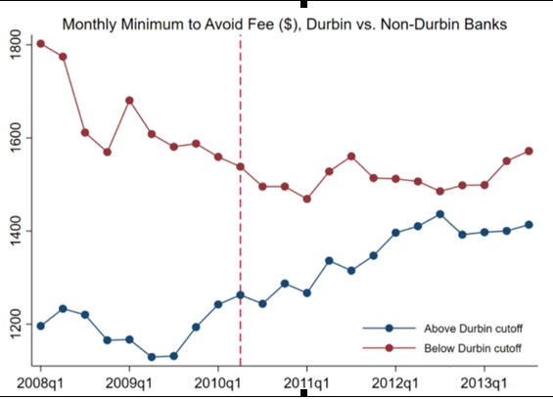
Minimum Balance for Free Increased 25% (M&S)

Slide 48
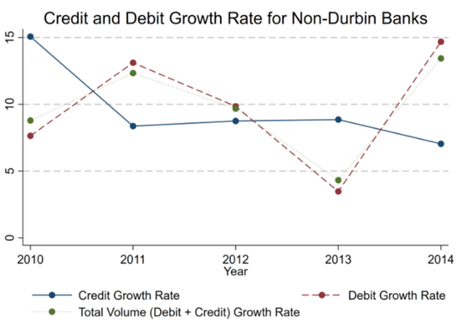
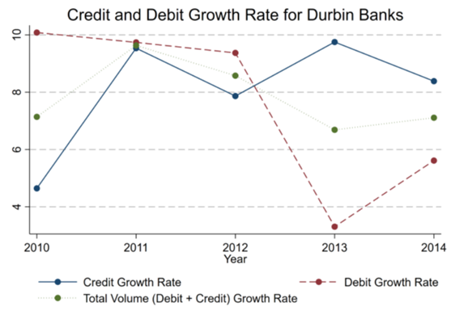
Substitution (Mukharlyamov & Sarin (2019))

Slide 49
Mukharlyamov & Sarin (2019): Retail Pass-Through
Examine prices in gasoline industry: Interchange fees feel by $6.5 billion annually and 15% of total savings to gas retailers
“Pass-through is greatest in regions where debit usage is most common… and competition is highest. However, outside of the top savers, we find no evidence that other gas retailers pass-through interchange savings in the six months following Durbin’s enactment.”
“Only those zipcodes with the largest Durbin savings (in the top 3 deciles) see a statistically significant decrease in retail gas margins. The decrease is most pronounced for the top decile of savers and then quickly falls off, with no statistically significant decrease for the seventh decile (average debit interchange savings of 22.9%) and below.”
Top decile of Durbin savers: Max price impact of $0.052
Top 3 deciles (only significant margin reductions): $0.032
53 percent pass-through overall

Slide 50
Mukharlyamov & Sarin (2019): Conclusion
“We can conclusively show that consumers experience immediate Durbin losses through higher bank fees, and we find limited evidence in the gas industry for across-the-board consumer gains through significantly lower merchant prices.”
“Importantly, even if merchants do pass along Durbin savings, the most sympathetic read of the evidence is that Durbin overall had zero impact on consumer welfare and had unintended distributional consequences, as higher bank fees are borne only by the poorest consumers, while everyone benefits from lower prices.”
“These higher fees are disproportionately borne by low-income consumers who account balances do not meet the monthly minimum required for these fees to be waived.”
“A rough back-of-the-envelope calculation suggests that banks make up approximately all Durbin losses.” (Versus 50% pass-through by merchants)

Slide 51
Retail Pass-Through?
Spain: 1% reduction in level of interchange fee=
0.17% reduction in retail price
0.0048% increase from cardholder (more usage)
Net 0.1668% price reduction
Richmond Fed Study
58% of merchants said no change
11% reduced costs
31% increased costs
25% saw increased small-ticket cost and 3% decreased
Costs seem to have gone down for large business and increased for small

Slide 52
Asymmetric Price Response
Where debit costs increased, most (2/3) raised retail prices
Where debit costs decreased, few (1/3) reduced retail prices (“the regression fails to run given that too few merchants reported a price reduction”)
77% made no change
1% decreased prices
22% increased prices

Slide 53
Why So Little Pass Through?
Pass through of decreased interchange into decreased Merchant Discount is not 1 to 1: Acquirers capture some of it too (at least in the short to medium run)
Interchange is a small part of overall costs: small savings don’t get passed through as much as larger costs (to banks)
Retail markets are less competitive than banks
Rockets-and-feathers

Slide 54
Same Results Elsewhere
Australia
Spain
Poland
EU

Slide 55
What does this mean for consumers?
Evans, Change Joyce (2013):
Pass-through by banks much larger than pass-through by retailers
= Huge wealth transfer from consumers to merchants
Net expected loss for consumers of $22-$25 billion NPV
Manne, Morris, Zywicki (2014)
Implications of low pass-through from merchants plus higher bank fees for poor
Households with income below $50,000 | 60 million
Households that have lost free bank accounts | 15 million
Monthly cost of household bank account | $10
Total annual cost to poorer households | $1 to $3 billion

Slide 56
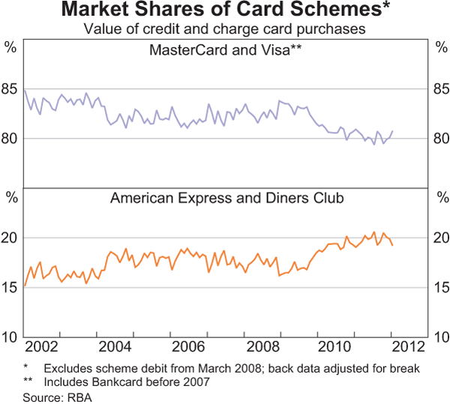
Substitution: Australia Three-Party Increased 25%

Slide 57
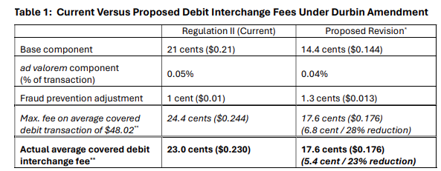
Revised Fed Rules
Regulation II 2011: Reduced fees >40%
2023 Proposed rule: Reduce by 5.4 cents (additional 23%) to 14.4¢ + 0.04% (4 basis points) + 1.3¢ Fraud Adjustment
Reduces bank revenues by $3 billion annually
Nick Bourke estimates consumer bank fees will increase by 1.3 billion to $2 billion (50-65% recoupment total)
Higher monthly maintenance fees: 1.3 billion (42% of recoupment)
Other fees: $250 million-$700 million

Slide 58
Corner Post (D. ND) v. Linney’s Pizza (ED KY)
Earlier decisions had relied on Chevron
Corner Post:
Durbin Amendment unambiguous
Holds Fed 2011 Rule improperly considered fixed costs and fraud prevention costs that were not permitted by the language of the Durbin Amendment which only permits “incremental” costs
Court stayed both its order and the revised rule
Linney’s Pizza:
Statutory language ambiguous
Fed could consider fraud prevention, network costs, and other costs as part of “reasonable and proportionate” costs

Slide 59
Corner Post
“Networks’ role in setting interchange fees has long been a boon to issuers at times, but not so much to merchants or consumers.”
“Before interchange fees became regulated in 2011, their price tags skyrocketed. More debit cards circulating in the market meant more revenue for networks, so networks set higher and higher interchange fees to entice issuers to push out more cards. As one would expect, issuing banks benefitted while merchants and consumers suffered as profits tightened and prices increased.”
What’s wrong with these claims?
Ignores two-sided market
Ignores pass through of bank costs to consumers
Ignores limited pass through of cost savings by merchants
Ignores costs of losing bank accounts
Increased bank costs > decreased retail prices

Slide 60
Credit Card Competition Act
Impose “competitive” routing for credit cards
Two networks per card, one cannot be Visa or MC
“PINless” debit
Prediction: Higher annual fees, lower rewards, higher interest rates, reduced investment in fraud and other quality terms
Just like Durbin
Are you indifferent with regard to routing?

Slide 61
Why Merchants Want Intervention
Public Choice/interest group theory
Merchants want to capture the rents of the developed payment card network without bearing costs
Will talk about surcharging later in the semester
Merchants know most consumers won’t stop using cards

Slide 62
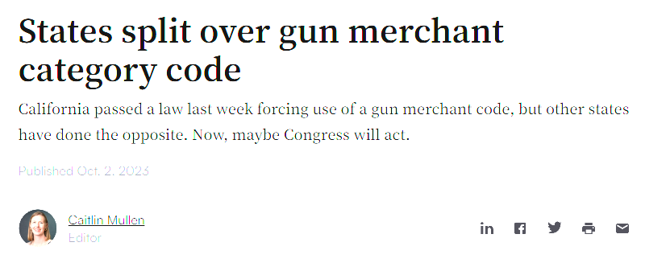
Politicization of Payments

Slide 63
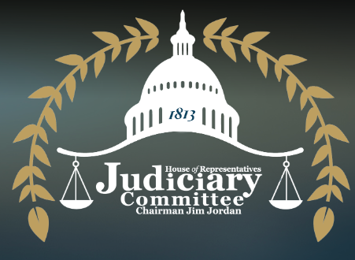
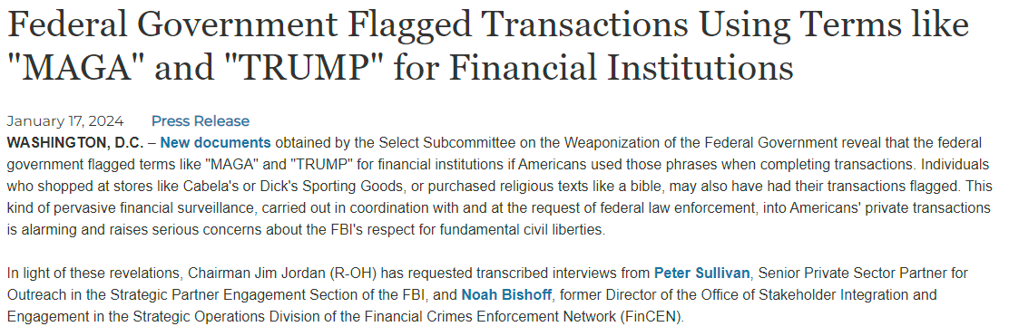
Financial Surveillance

Slide 64
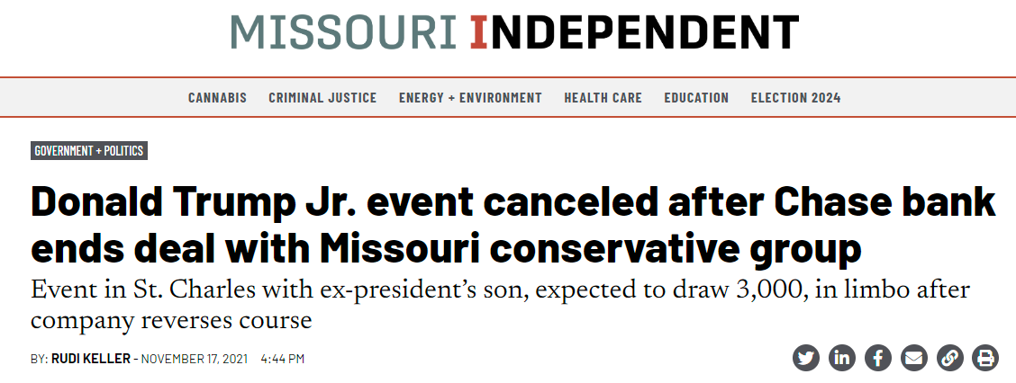
Leveraging Payments

Slide 65
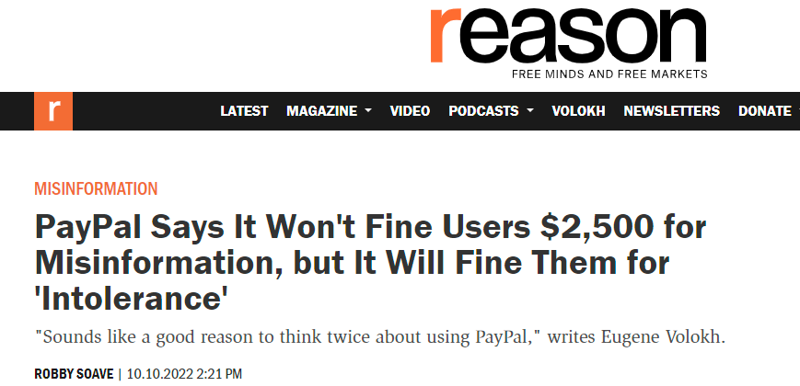
Payments and Speech

Slide 66
Conclusion
Adoption of payment cards has huge benefits for consumers, merchants, and society
2-sided markets are very complex: Must balance demand and acceptance
Theoretical arguments for market failure depend on assumptions
Empirical evidence for market failure still open
Effects:
Higher cardholder fees
Reduced benefits
Substitution
Pass-through
Effects highly dependent on local country conditions
Public and Private Incentives Must Work Together

Slide 67
Regulation
EFTA and Reg E
TILA and Reg Z

Slide 68
Payments Liability Rules
Five Issues:
Speed
Costs
Authorization
Errors
Finality

Slide 69
Tradeoffs
Zelle and real-time payments: tradeoff between finality and errors
What if you “authorize” a payment to someone but it turns out the recipient is a fraudster or you type in the wrong phone number
So you authorized it (your card wasn’t stolen or your account hacked) and you thought you sent it to your brother but it turns out it was someone impersonating your brother
Who is liable for the transfer (assuming the scammer can’t be located)?
Traditionally consumer: CFPB tried to impose liability on bank
But note the potential here for fraud
But shows the dangers: The more final the transaction the more difficult it is to unwind

Slide 70
Scope of EFTA: 15 USC 1693
EFTA covers “electronic fund transfers”
15 USC 1693a(7), 12 CFR 1005.3: EFT is defined as “means any transfer of funds…which is initiated through an electronic terminal, telephonic instrument, or computer or magnetic tape so as to order, instruct, or authorize a financial institution to debit or credit an account.”
As we will see, the difference between a “debit card” and a “credit card” is the debit card draws from “an account” and credit card draws from a “line of credit”
Some exclusions: notably overdraft or bounced check fee

Slide 71
“Electronic Fund Transfer”
Must be:
A transfer of funds
Initiated through some sort of electronic device
That directs a financial institution to
Make a payment to/from
An account
“Financial Institution” 1693a(9): state or national bank, credit union, or “any other person who directly or indirectly holds an account belonging to a consumer”
“Account” 1693a(2): demand deposit (checking), savings deposit, or other asset account “established primarily for personal, family, or household purposes”
1693a(7), 12 CFR 1005.2(b)(1): Includes ATM, direct deposits, automatic bill payments via ACH, telephone payments
Excludes credit, prepaid cards, and small business debit

Slide 72
Authorization
“Unauthorized Electronic Fund Transfer” 1693a(12), 12 CFR 1005.2(m): “means an…
electronic fund transfer
from a consumer’s account
initiated by a person other than the consumer
without actual authority to initiate such transfer and
from which the consumer receives no benefit”
Transactions are considered “not unauthorized” if 15 USC 1693a(12), 12 CFR 1005.2(m)(1)-(2):
(A) initiated by someone to whom the consumer gave the “access device” (the card or the digits on the card), unless the consumer has notified the financial institution involved that transfers by such other person are no longer authorized
(B) first-party fraud by the consumer or someone in cahoots with the consumer,
12 CFR 1005.2(m)(3):Transfers initiated by the banks such as account fees
(C) error by the financial institution: Bank can’t mess up and then call it unauthorized so treated as “errors” not “unauthorized” and trigger liability rules

Slide 73
Consumer Liability for Unauthorized Transfers
15 USC 1693g(a), 12 CFR 1005.6(a): Consumer has no liability for unauthorized electronic funds transfer unless
“accepted card or other means of access” used (no liability if no card/access used)
The bank that issued the card or other access device provided means for identifying the consumer (signature, photo, fingerprint, electronic confirmation)
“access device” 12 CFR 1005.2(a)(1): “card, code, or other means of access to a consumer’s account… that may be used to initiate electronic fund transfers”
“accepted access device” 12 CFR 1005.2(a)(2): when consumer requests and received the access device: concern was “hot cards”
What about “cloned cards” or the digits on the card?
“means of identifying the consumer” 15 USC 1693g(a): signature, photograph, fingerprint, or electronic or mechanical confirmation
Includes PIN: CFPB Official Interpretation to 12 CFR 1005.6(a)

Slide 74
Liability for Past Unauthorized Transactions
Two tiers of liability based on consumer “contributory negligence” (sort of)
Consumer liability for each unauthorized EFT
15 USC 1693g(a)(1), 12 CFR 1005.6(b)(1): $50 min
15 USC 1693g(a)(2), 12 CFR 1005.6(b)(2)): If consumer does not give notice within two business days, liability increases to $500 for losses bank can should would not have occurred had the consumer given timely notice of the “loss or theft” of the access device.
Loss cap is per transfer not per incident
If loss is not due to card being lost or stolen, on $50 cap applies
Unclear whether transaction using stolen digits or cloned card involves “loss or theft”
Compare to $50 cap under TILA for credit cards
But note some payment card networks have “zero liability” policies: Visa waives $50 if you notify bank promptly

Slide 75
Future Unauthorized Transactions
1693g(a)(2), 12 CFR 1005.6(b)(3)
What if a transaction occurs that you don’t know about until it appears on your account statement?
You have 60 days from the transmittal date of the statement to notify issuer
After that consumer has unlimited liability for all unauthorized transactions that occur between the end of those 60 days and the provision of notice to the issuer, provided the issuer can show the transactions would not have occurred had there been timely notice
If no notice ever provided, no cap on liability
60 day limit can be extended for extenuating circumstances (such as travel or hospitalization): 15 USC 1693g(a)(2), 12 CFR 1005.6(b)(4)

Slide 76
EFTA Error Resolution
15 USC 1693f, 12 CFR 1005.11
“Error” includes both unauthorized and incorrect transactions: 15 USC 1693f(f), 12 CFR 1005.11(a)(1)(i)-(ii)
12 CFR 1005.11(a)(iii)-(iv): “error” includes omission of transactions from periodic statements, incorrect receipts, and any request by consumers for additional clarification or info
If consumer provides notice within 60 days of transmittal of the periodic statement then triggers processes for bank to address it: 12 CFR 1005.11(c)(4)

Slide 77
Error Resolution Process
12 CFR 1005.11(c)(1)
Once bank notified of error required to undertake and complete an investigation within 10 business days
Report to consumer within 3 business days from completion of investigation
Correct any error within 1 business day
If unable to complete investigation within 10 business days may take up to 45 days total but must provisionally re-credit consumer’s account (and withhold $50 for unauthorized transactions)
12 CFR 1005.11(d)(1): If bank determines no error, then bank must provide written explanation
If consumer not satisfied may pursue remedies in court: EFTA error resolution process mandatory for bank but not consumer

Slide 78
Automated Clearinghouse (ACH)
Mostly follows EFTA and Reg E: 12 CFR 1005.2(b)(2)
Except “represented checks”: checks that bounced and were converted into ACH for re-presentment
Electronic debits and bounce fees (including overdraft) are covered by EFTA but ACH re-presentment are not
Pre-authorized electronic fund transfers (i.e., recurring bill payments):
15 USC 1693e, 12 CFR 1005.10(b): must be written authorization (not just a debit swipe)
Stop payment right: 15 USC 1693e, 12 CFR 1005.10(c)
Also subject to National Automated Clearinghouse Association (NACHA) Rules
Requires authorization for all ACH
Create stop payment right

Slide 79
Credit Cards
Truth in Lending Act and Regulation Z
15 USC 1602(l): “The term ‘credit card’ means any card, plate, coupon book or other credit device existing for the purpose of obtaining money, property, labor or services on credit.”
15 USC 1602(j): “open end credit plan” means “a plan under which the creditor reasonably contemplates repeated transactions, which prescribes the terms of such transactions, an which provides for a finance charge which may be computed from time to time on the outstanding unpaid balance.”
12 CFR 1026.2(a): “credit card means any card, plate. Or other single credit device that may be used from time to time to obtain credit.”

Slide 80
Unauthorized Credit Card Transactions
15 USC 1602(p): “unauthorized use” means “use of a credit card by a person other than the cardholder who does not have actual, implied, or apparent authority for such use and from which the cardholder receives no benefit.”
12 CFR 1026.12(b)(i) [note book on page 394 incorrectly says 12 CFOR 1016.12(b)(i)]: “unauthorized use” means “the use of a credit card by a person, other than the cardholder, who does not have actual, implied, or apparent authority for such use, and from which the cardholder receives no benefit.”
Note that unlike debit cards, implied or apparent authority to use a credit card is not an unauthorized use vs. EFTA which requires actual authority.
12 CFR 1026, Supplement I, Official Interpretation 12(b)(1)(ii): if cardholder grants apparent authority, not unauthorized even if person acts outside scope of actual authority unless notify credit that use by such person is no longer authorized.

Slide 81
“Accepted Credit Cards”
Consumer liable for unauthorized use only if
(1) Credit card is “accepted”
(2) Issuer has provided a method to identify the person authorized to use it
15 USC 1643(a)(1)(A): cardholder liable for unauthorized use only if the card is “an accepted credit card”
12 CFR 12(b)(2)(i): cardholder liable for unauthorized use only if the card is an “accepted credit card”
15 USC 1602(m): “accepted credit card” means credit card the consumer has actually requested and received
So if card stolen by a fraudster in the mail before receipt, no liability
If digits stolen or cloned card presumably not an “accepted credit card”

Slide 82
“Means to Identify the Cardholder”
15 USC 1643(a)(1)(F): Issuer must also provide a method to identify the person authorized to use the card
12 CFR 1026.12(b)(2)(iii): Means to identify the cardholder
Official Interpretation: signature, photograph, fingerprint or other biometric means, or electronic or mechanical confirmation
Use of a magnetic strip does not constitute a sufficient means of identification unless “used in conjunction with a secrete code or the like” (i.e., PIN).
Where card not present (such as phone or internet), cardholder is never liable, even if provide additional information such as the credit card account number or the card expiration date plus a CVV because no means to identify the cardholder

Slide 83
Liability
15 USC 1643(a)(1)(B), 12 CFR 1026.12(b)(1)(ii): Single tier of liability = $50
15 USC 1643(d): Exclusive liability is $50 for unauthorized use
Zero liability for unauthorized use for card-not-present transactions
No contributory negligence
no notice requirement for cardholders to notify issuer but consumer not liable for any loss following notice (only matters if <$50 liability when provide notice): 15 USC(a)(1)(E)
Networks may also further limit cardholder’s liability (Visa zero liability): 15 USC 1643(c), 12 CFR 1026.12(b)(4)
Contra EFTA, TILA liability rules apply to business credit cards too: 15 USC 1602(n)
12 CFR 1026.2(a)(8): “cardholder” means “natural person” but “for purposes of 1026.12(a) and (b) the term includes any person to who card issued for any person including business, commercia or agricultural use”

Slide 84
Error Resolution
15 USC 1666(b)(1), 1666(b)(4), 1666(b)(5): actual billing errors
12 CFR 1026.13(a)(4)-(5)
15 USC 1666(b)(3), 12 CFR 1026.13(a)(3): billed for goods not accepted or returned because of quality issues
15 USC 1666(b)(1), 12 CFR 1026.13(a)(1): Unauthorized transactions
15 USC 1666(b)(6), 12 CFR 1026.13(a)(2), 12 CFR 1026.13(a)(8): billing and disclosure requirements
15 USC 1666(b)(2), 12 CFR 1026.13(a)(7): requests for clarifications of items on periodic statement
Note that disputes with the merchant about the quality of the merchandise are covered by TILA/Reg Z error process
15 USC 1666i even allows consumer to raise merchandise quality issues with the merchant as a defense against the card issuer

Slide 85
Duty to Investigate
Consumer commences procedure via notice to FI
W/in 60 days of transmittal of billing statement Can be oral or written
Must enable FI to identify consumer and account number
Indicate that there is an error and what it is.
FI then has duty to investigate.
Must do so and notify consumer of result within 10 days or credit consumer’s account.
Alternatively, must give provision recredit and finish investigation within 45 days.
Errors must be credited within 1 business day.
Treble damages if failure to recredit or bad faith investigation.

Slide 86
Raising Claims Against Merchants Against Issuers
Issuer is functionally the assignee of the merchant
15 USC 1666i: any claims against merchant for defective products can also be raised against the issuer
Must be > $50, cardholder has to have tried to resolve the issue in good faith, etc.
12 CFR 1026.12(c)(1)-(2): cardholder can withhold payments from card issuer while dispute with merchant outstanding

Slide 87
Financial Institution Liability
15 USC 1693h
FIs are liable for:
Excess liability on unauthorized transactions
Proximate damages for failure to make a valid EFT
Including where NSF resulted from a failure to properly credit payments.
Proximate damages for failure to honor a stop payment order
Intent irrelevant for liability.
Exceptions
Divine acts
Consumer knowledge of technical malfunction

Slide 88
Problem 19.2
Who bears the loss?
If check or cash?
If pay by credit card?
Acquirer or issuer? Why?

Slide 89
Problem 19.2
Check or cash?
Breach of contract and maybe tort suit for fraud
Not going to recover much because bankrupt: pennies on the dollar
Credit card?
15 USC 1666i: paid by credit card and didn’t receive promised goods and services
Should be able to get a refund from card issuer
So issuer has the loss, at least initially
What can issuer do? Subrogated to consumer rights so can seek to recover from the acquirer
Then the acquirer will be the one left holding the bag and trying to collect from Ja Rule—so acquirer ends up holding the chargeback risk
Acquirer includes chargeback risk in merchant discount fee
So companies/industries with high chargebacks pay higher fees (ex. Adult websites)

Slide 90
Problem 19.3
What are costs and benefits of each system for employees?
Cash: Don’t need bank accounts, can evade taxes and garnishment, but risk of theft and unpredictable liquidity. Also have to show up in person
Check: Gives Burger Urger float but employees can’t access funds for a few days and unbanked employees will have to use check cashers and have to carry lots of cash
Prepaid payroll debit cards: cost of issuing cards and maintain program, often has fees for consumer use
ACH: Consumers will need a bank account but low-cost to Burger Urger and don’t have to transfer until last minute
“Payment Choice Act”: Why merchants go cash-free

Slide 91
Problem 19.6
What rights does Mullen have against Apple?
If payment isn’t received?
If double-billed?
Rights against banks under TILA and EFTA?

Slide 92
Problem 19.6
Rights against ApplePay?
Pass-thru wallet so rights are the same as if used a card
All ApplePay does is tokenize the payment data stored on his phone
Liability for funds not transmitted?
No liability: 15 USC 1693h(a)(1): failure to make an EFT in accordance with the terms and conditions of the account
Double billed? He has TILA and EFTA resolution rights against ApplePay (depending on if credit or debit): 15 USC 1666(b) (EFTA), 15 USC 1666i (TILA)
Against ApplePay? No. Just against banks because statute gives no rights against Apple for erroneous billing by the banks
Even if the fault is ApplePay (say processing the transaction twice) his rights are against the bank which will then deal with Apple

Slide 93
Problem 19.7
Is Apple subject to CFPB UDAAP enforcement or rulemaking?
Tuns on whether Apple is a “covered person”

Slide 94
Problem 19.7
Is Apple a “covered person” for purposes of UDAAP?
12 USC 5481(6): any person that engages in offering or providing a consumer financial product or service
12 USC 5481(5): “consumer financial product or service” if ApplePay wallet is a “financial product or service” that is “offered or provided primarily for personal, family, or household purposes”
ApplePay is offered for personal purposes so “consumer”
Is it a “financial product or service”?
Yes: 12 USC 5481(15)(vii): and is providing “payment or other financial data processing services to a consumer by any technological means” 12 USC 5481(15)(vii)
Could be other categories too:
12 USC 5481(15)(v)
12 USC 5481(15)(iv) (probably means bank accounts and remittances but might be broad enough)

Slide 95
Problem 20.6
20.6.a. What is your liability for Mallory’s shopping spree with your debit card?
20.6.b. Does the result change if it was a credit card instead of a debit card?

Slide 96
Problem 20.6.a
Your liability for unauthorized debit card use?
15 USC 1693g(a), 12 CFR 1005.6(a): consumer liable for unauthorized electronic fund transfer if:
“accepted card”
Means of identification
15 USC 1693a(1): not an “accepted card” because never received it
12 CFR 1005.2(a)(b): “accepted access device” when consumer requests and receives the “access device”
So no liability

Slide 97
Problem 20.6.b.
What if a Credit card?
15 USC 1643(a): cardholder liable for unauthorized use of debit card only if:
Card is an accepted credit card
Liability not in excess of $50
Unauthored use occurs before card issuer notified
Card issuer provides a means of identification
What about here? No liability. Why?
15 USC 1602(m): Card was not an “accepted” card because you never “received” it so no liability

Slide 98
Problem 20.7
Jack Dawkins picks your pocket and passes your credit card onto the fence Fagin:
20.7.a. Fagin purchases $1000 antique silver snuffbox at jewelry store
20.7.b. Does answer change if a debit card?
20.7.c. Purchase on eBay?
20.7.d. Does answer to c change if debit card?

Slide 99
Problem 20.7.a.
Problem 20.7.a. Stolen physical card used in card-present transaction
Cardholder liable if
Accepted card
Means of identification
Was it “accepted”? Yes—15 USC 1602(m), 15 USC 1643(a)(1)(A)
Was there a means of identification? Probably—15 USC 1643(a)(1)(F), 12 CFR 1026.12(b)(1)(iii) if signature or picture on card
If not, then no liability even though card accepted
Note that if you never sign your card then never liable if merchant takes it!
If card accepted and a means of identification, then consumer is liable. For how much?
15 USC 1643(a)(1)(B), 12 CFR 1026.12(b)(1)(ii): Up to $50
But Visa Zero Liability Policy probably limits to zero in practice
Note that consumer only liable for $50 no matter how negligent or otherwise contribute to the theft or misuse and no duty to notify the issur

Slide 100
Problem 20.7.b
Same facts but stolen debit card
15 USC 1693g(a), (e): Liable if card accepted and user can be identified
Accepted: Yes
Means of Identification? Maybe. Depends on if PIN or signature
PIN: Yes—not clear how thief gets the PIN, so unlikely scenario
Signature: If have a signature or picture, etc.
If accepted and consumer can be identified, then consumer liable for unauthorized transaction as follows:
15 USC 1693g(a)(1): Liability limited to lesser of $50 or amount of charges if reported within two days
15 USC 1693g(a)(2): If report within two days after theft but within 60 days of transmittal of periodic statement, then liable for all charges between end of 2 days and the date you provide notice, except liability capped at $500 or amount of the unauthorized transactions (whichever less)
If fail to report within 60 days of transmittal of bank statement then responsible for all charges
Unlike CC, there is a contributory negligence element here

Slide 101
Problem 20.7.c. and d.
20.7.c. Now credit card data used CNP environment. Liability?
No, because no way to verify identity
15 USC 1643(a)(1)(F), 12 CFR 1026.12(b)(1)(iii)
20.7.d Data from debit card used in CNP. Liability?
No, Same as CC because no ability to verify identity:
15 USC 1693g(a)
Unless PIN debit used for CNP (doesn’t really exist)

Slide 102
Problem 20.8.
Boris Levitin has stolen your card data and created a new card.
Note that the installation of the chip in your card has largely removed this ability to create new cards from stolen data, which was easy to do when magnetic stripe
20.8.a. Boris makes a purchase at Best Buy
20.8.b. When you learn of it
20.8.c. Debit card with recurring charge
20.8.d. Used the stolen digits to shop at Amazon

Slide 103
Problem 20.8.a.
Boris makes a purchase at Best Buy
What’s the issue? 15 USC 1643(a)(1): Is this an accepted credit card (1643(a)(1)(A)) and has the issuer provided a means of identification (1643(a)(1)(F))?
Probably not “accepted.” The one and only accepted card is still in your wallet. This card does not seem to have been “received” by you
Also seems like there is no means of “identifying” the user as a cardholder because you haven’t signed the card nor is there a photo or PIN

Slide 104
Problem 20.8.b.
You wait 150 days after learning about unauthorized use before report it. Does that matter?
No—assuming you either didn’t “accept” the card or issuer did not provide a means of “identifying” yourself, still no liability
15 USC 1643(d)

Slide 105
Problem 20.8.c.
Debit card: Now EFTA applies
EFTA, 15 USC 1643(a)(1): card must still be “accepted” (1643(a)(1)(A)) and “identification” (1643(a)(1)(F))
Reg E: 12 CFR 1005.6(a): Contributory negligence limit on $50 liability limit (not entirety of liability)
Was card “accepted”? 15 USC 1693a(1): “card, code, or other means of access”—does it have to be the card or are the digits enough (“code”)?
Note that digital wallets (like ApplePay) use the digits, not the physical card, so possible digits might potentially qualify as the “accepted” card
If so, what about ID? 15 USC 1693g(a): Might sign original card but “cloned”? Official Interpretation 6(a) allows PIN

Slide 106
Problem 20.8.c. (continued)
What if tests satisfied for liability (“accepted” and “means of identification”). How much is consumer’s liability?
If consumer properly notifies bank with 2 business days of learning of loss then $50 cap
If does not notify within 2 business days after learning of loss, then liable for any amount after those two business days up to $500 that bank can show would have avoided if proper notice
12 CFR 1005.06(b)(2): ex., if card stolen on Monday, $100 in unauthorized transactions on Tuesday and $700 on Friday before consumer notifies bank, then consumer liable for $500 ($50 on Tuesday (within first two days) and $450 for Friday because of $500 total cap)
But if $700 on Tuesday and $100 Friday, then total liability of $150 ($50+$100)

Slide 107
Problem 20.8.c (continued)
What about here—the statement transmitted 13 days after the fraud and you looked at it two days later but you didn’t report it for 150 days?
You are well outside the two day notice window from actual knowledge so kicks up to $500 liability cap
Review: Lost/stolen cards
If you report unauthorized transfer within 2 business days after learning of loss/theft then $50 cap
If you report unauthorized transfer more than 2 days after learning of loss/theft but within 60 days of banks transmittal of the statement, $500 or amount bank can show would’ve been avoided during 60 day window

Slide 108
Problem 20.8.c.
What about if not lost/stolen (stolen digits).
“60-Day Statement” Rule (15 USC 1693g(a)(2)) (“notwithstanding the foregoing”):
60 days from transmittal of statement to report error
So here the periodic statement was transmitted 13 days after the charge + 60 days = 73 days
If report within 60 days of statement transmittal then zero liability
Unlimited liability for any charges more than 60 days after transmittal until you give notice
Here?
$500 cap for tv using stolen card
Responsible for all Netflix charges because even though made within 60 days after card stolen and transmittal, the clock starts ticking 60 days after transmittal (so days 73, 103, and 133 all within 150 days)

Slide 109
Problem 20.8.d.
Used stolen digits to make purchase at Amazon
No liability because CNP: NO means of identification: 1693g(a)

Slide 110
Problem 20.13
12 CFR 1026.13(a)(6): Right to request additional clarification of the charge
12 CFR 1026.13(d)(1): Right to withhold payment pending clarification of the charge

