Slide 1
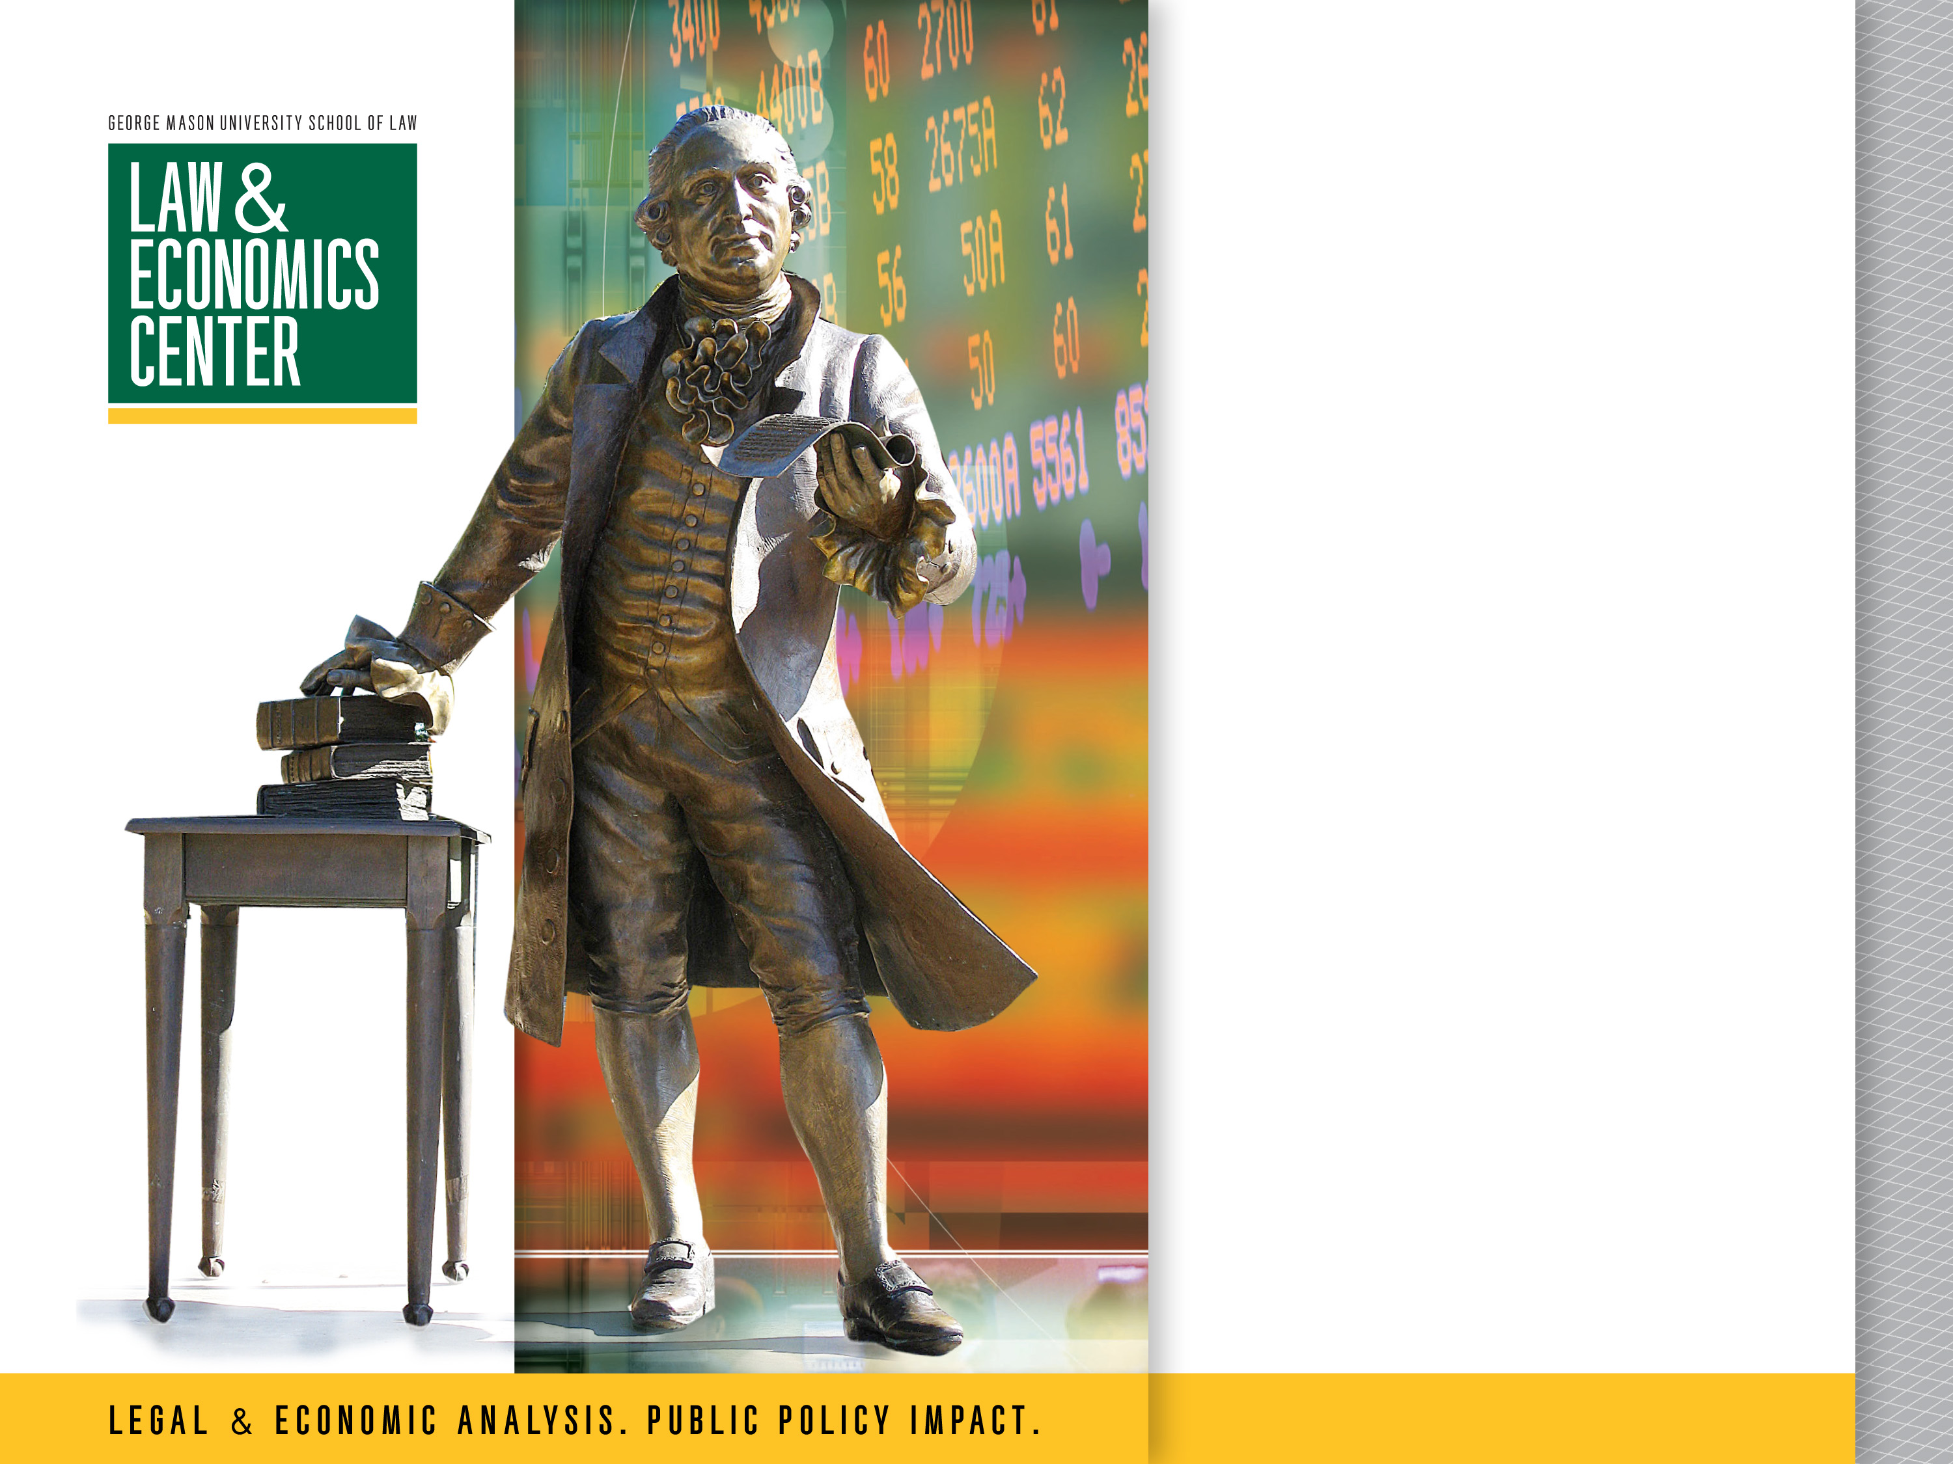
Class 3: Unfair, Deceptive, and Abusive Practices (UDAAP)
Presented by
Todd J. Zywicki George Mason University Foundation Professor of Law

Slide 2
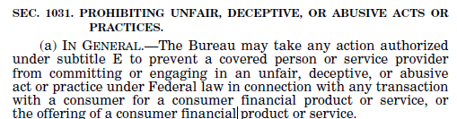
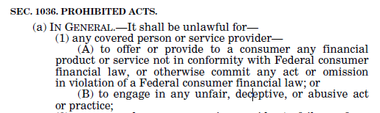
Dodd-Frank Section 1031 and 1036: UDAAP

Slide 3
UDAAP
Unfair
Substantial injury to consumers
Consumers cannot reasonably avoid
Harm outweighs any benefit to consumers or competition: Cost-Benefit
Deceptive
Material, misleading statement or omission + reasonable reliance
Broader than common law fraud
No scienter requirement
No reliance requirement
Does not require a false statement or omission; misleading is enough
Abusive
Materially interferes with ability of consumer to understand product
Takes unreasonable advantage of consumer’s lack of understanding of the product
Takes unreasonable advantage of inability of consumer to protect her interests, or
Takes unreasonable advantage of reasonable reliance by consumer on covered person to act in her interests.
Notes:
Small injury to many consumers is substantial
Reasonably avoidable—not whether consumers could have made a better choice. Similar to “absence of meaningful choice” prong in unconscionability. If search costs are high, it’s reasonable not to search.
Cost-benefit analysis

Slide 4
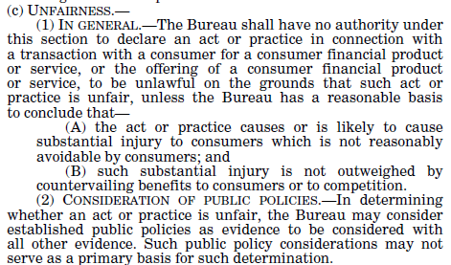
Unfairness 1031(c)

Slide 5
Deceptive
Not defined term in Dodd-Frank

Slide 6
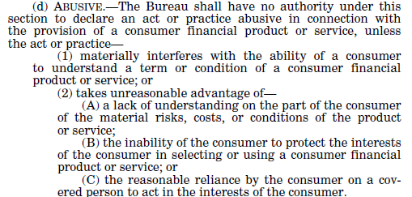
Abusive

Slide 7
Unfairness
Definition goes back to 1982 Policy Statement at FTC after excesses of 1970s
Later codified
Cost-Benefit analysis

Slide 8
Unfairness: CFPB Supervision Manual (p. 174)
“Likely to cause substantial injury”:
“Act of practice that causes a small amount of harm to a large number of people may be deemed to cause substantial injury.”
“Actual injury is not required in every case. A significant risk of concrete harm is also sufficient.”
“Must not be reasonably able to avoid the injury”:
“Normally the marketplace is self-correcting; it is governed by consumer choice and the ability of individual consumers to make their own private decisions without regulatory intervention.”
Key question is not whether consumer could have made a better choice but “whether an act or practice hinders a consumer’s decision-making”
Consumers must have reasonable means to avoid it
Lack of market alternatives? Is this similar to unconscionability?
Injury not outweighed by countervailing benefits to consumers or competition: Including lower prices

Slide 9
Discrimination as Unfair
CFPB Supervision and Examination Manual (Mar. 2022)
“Foregone monetary benefits or denial of access to products or services, like that which may result from discriminatory behavior, may also cause substantial injury.”
“There are many instances where consumers simply have no mechanism to avoid the injury. For example, consumers typically cannot avoid the harms of discrimination.”
Chamber of Commerce v. Consumer Financial Protection Bureau, United States District Court, Eastern District of Texas, https://www.consumerfinancemonitor.com/wp-content/uploads/sites/14/2023/09/Opinion-and-Order.pdf

Slide 10
Unfair-In re RBS Citizens Financial Group Consent Order
What’s a consent order?
What was the alleged bad behavior?
RBS Citizens resolved “deposit discrepancies”—mismatches between deposit slip and amounts on checks/cash for amounts under $50 in favor of the slip, which often favored the bank.
Consumers undercredited by $12.3M over 2008-2013 period.
Substantial injury?
Small harm, but to many consumers
Not reasonably avoidable?
How could a consumer avoid this?
Benefit to consumers/competition?
What about consumers who came out ahead? What if more of them came out ahead?
Can you know, ex ante, which group you’ll be in?
Remedy?
$11M in restitution and $7.5M in civil monetary penalties.

Slide 11
Wells Fargo
Well known case
Opened accounts without customer knowledge or permission, then charged fees for failure to keep minimum balance!
Unauthorized credit card applications/accounts
“Unfair”?

Slide 12
Deception (p. 182)
A representation, omission, act, or practice:
The representation, omission, act, or practice misleads or is likely to mislead the consumer
The consumer’s interpretation of the representation, omission, act, or practice is reasonable under the circumstances; and,
The misleading representation, omission, act, or practice is material.
“Material”:
“if it is likely to affect a consumer’s choice of, or conduct regarding the product or service.”
Actual harm not required: injury inferred from materiality (different choice)
“Deception… involves a material representation, omission, or practice that is likely to mislead a reasonable consumer.”
Deception does not require intent (“scienter”): tracks contract law (vs tort)
Look at impact on consumer not intent of provider
A statement could be true but misleading (in context)

Slide 13
Deceptive-In re Dwolla, Inc. Consent Order
Dwolla is a Venmo-like payments company.
What is the alleged deception?
Falsely represents that its data security practices “exceed industry standards” and that all consumer info is 100% encrypted and stored securely and in compliance with PCI standards.
Does it matter if no consumer actually relied on the specific statements?
No, CFPB only has to show that statements are misleading, material, and that a reasonable consumer would rely on these statements.
Are statements about payments data security always material?

Slide 14
Discover
Add-On Services
Credit insurance-type products
What did Discover do?

Slide 15
Problem 10.1: Deception
Threshold Jurisdiction Issue for Auto Dealers
12 USC 5519: Exclusion for Auto Dealers
12 USC 5481(26): Service Provider—Slaab
Slaab doesn’t make leases: markets on behalf of independent dealers which then assign leases to Slaab
Dealers are “covered persons” under 5481(15)(A)(ii) (because leases re equivalent of purchase finance arrangements) but dealers outside CFPB jurisdiction under 5519.
Slaab: Slaab not a covered person because doesn’t extend leases just purchases them—purchasers of leases not included in 5481(15)(A)(ii) unlike 5481(15)(A)(i) which covers purchasers of credit
But still “covered person” under 5519
5481(26): So can be a “service provider” to the dealers because provide material service to covered persons—designs and markets leases
See RBS Citizens Financial: holding company is service provider to bank

Slide 16
Problem 10.1
Deception:
Representation or omission likely to mislead
Reasonable consumer
Material: likely to affect consumer’s choice
“No money down”
Small print disclosure:
Disclosure at lease signing: Does corrective disclosure cure?
Does scienter/intent or consumer showing reliance matter?
Does Compliance with Regulation M protect Slaab?

Slide 17
Problem 10.1
Deception:
Representation or omission likely to mislead
Reasonable consumer
Material: likely to affect consumer’s choice
“No money down”: Yes, would likely mislead reasonable consumer to believe would not have to put any money down and would only owe monthly payment when actually will owe $1000
Goes to price so inherently material
Small print on commercial doesn’t cure it
Disclosure at lease signing: Does corrective disclosure cure? No, the deception occurred when consumers acted on the initial deception and it affected choice
Does scienter/intent or consumer showing reliance matter? No. Just materiality
Regulation M: No, compliance with statutory requirement is not a UDAAP Defense

Slide 18
Problem 10.2: Unfairness
12 USC 5531(c)
Unfairness
Substantial consumer harm
Harm not reasonably avoidable by the consumer: compare Wells Fargo
Harm is not outweighed by benefits to consumer or competition
Substantial harm?
Overpriced junky car ($8k resold for $3k)
High rate of default
Loan exceeds realistic life of car absent substantial repairs
Reasonably avoidable? Probably other car dealers but similar
Consumer Harm Outweighed by benefits:
Difficulty of Cost-Benefit analysis
What is harm to her and others if they can’t buy cars?
¼ default, ¾ don’t: How do we compare?

Slide 19
Problem 10.3.a: Unfairness
Unfairness
Substantial consumer harm
Harm not reasonably avoidable by the consumer: compare Wells Fargo
Harm is not outweighed by benefits to consumer or competition
Substantial harm?
Small amounts ($20) that can add up. But “substantial”?
Can we consider aggregate harm across many consumers?
Reasonably Avoidable? Can’t they just not overdraft?
Note frequent overdrafters are more likely to be aware than others
Benefits>Costs?
Harm to consumers with more overdrafts
Benefits to consumers who want larger payments covered (if more important)
10.3.c.: Deceptive?

Slide 20
Problem 10.3.b. Unfairness
Given notice, but arguably less than adequate notice
Told customers something changed but not clear what
Relevant? Affects whether “reasonably avoidable harm”: notice, but not clear

Slide 21
Problem 10.3.c. Deceptive
How?
If change in policy without adequate notice has a material omission (details about the policy change) that are likely to mislead a reasonable consumer
Note could be both unfair and deceptive
The literal truth of the statement (something “may have changed”) does not protect against omission

Slide 22
Abusive
Abusive
Materially interferes with ability of consumer to understand product
Takes unreasonable advantage of consumer’s lack of understanding of the product
Takes unreasonable advantage of inability of consumer to protect her interests, or
Takes unreasonable advantage of reasonable reliance by consumer on covered person to act in her interests.
Note: Does not appear to require weighing of benefits to consumer or to other consumers
Trump I CFPB Policy Statement required consideration of benefits (like unfairness)

Slide 23
Abusive—All American Check Cashing Compliant
What does All American Check Cashing do that is allegedly abusive?
Materially interferes with consumers’ ability to understand terms and conditions of product.
Hides its fees from consumers—positions consumer so consumer cannot see fee schedule, physically covers up receipts, has policy not to tell consumers the fee
Takes unreasonable advantage of consumers’ inability to protect their interests.
Stamps check immediately and then tells consumers that they cannot cancel the transaction or cash their check elsewhere when consumer objects regarding price.

Slide 24
Abusive—CFPB v. Cash Call
What does Cash Call do that is allegedly abusive?
Makes illegal loans —no state licenses and the loans also violate state usury laws.
Attempts to collect illegal loans without informing consumers that it has no right to do so.
Takes advantage of consumers’ lack of understanding of material risks, costs, conditions.
“Abusive” vs Unfair/Deceptive
Notice how the CFPB transforms state law violations into a federal law violation!

Slide 25
CFPB v. PayPal
Taking Unreasonable advantage of the inability of the consumer to protect his interests
“Bill Me Later” is a Buy Now Pay Later
If you opened multiple lines on different dates payments were allocated across all of the outstanding balances regardless of when opened and expiring rather than paying off FIFO—consumers thought they were paying off balances with deferred interest but ended up getting charged
PayPal didn’t explain it well
Consumer could contact the company if questions but PayPal made it almost impossible to talk to someone

Slide 26
Abusive—CFPB v. Freedom Stores
What does Freedom stores do that is allegedly abusive?
Lender specializes in lending to military families.
Contracts include a forum selection clause of Norfolk, VA and sues consumers there for default judgments.
Takes unreasonable advantage of consumers’ inability to protect their interests.
Consumers often aren’t aware of forum selection clause.
Consumers can’t negotiate forum selection clause.
Cf. Carnival Cruise Lines v. Schute (SCOTUS 1991-admiralty jurisdiction)

Slide 27
Abusive—CFPB v. College Education Services
Taking unreasonable advantage of consumers’ reasonable reliance on a covered person to act in the consumer’s interest
Represented that could help student loan borrowers get out of default and refinance loans at lower rates and stop wage garnishments, etc.
CES telemarketers held themselves out as loan counselors and advisors with the expertise to help consumers with their particular situations and to induce consumers to reasonably rely on the company to act in their interests in seeking and selecting student loan debt-relief plans
Took fees for consumers who were ineligible for consolidation or did not otherwise qualify for promised relief

Slide 28
Payday Loan Rule
Use of Abusiveness in Rule-Making
Covers short-term payday loans and auto title loans
Payday Loans: Typically two weeks with lump-sum due at the end
Borrow $300 @ $15/100=Receive $245 and repay $300 in two weeks
Can “rollover” by borrowing again to pay off
Auto Title Loans: Like a pawn loan but pledge car title and keep car
Usually 30 days but can prepay
If default, lender has right to repossess car—usually non-recourse (in practice even if not by contract)
Can rollover if can’t pay amount due
Both have high APRs
Grounded in Behavioral Economics
Consumers Lack and Understanding of Material Risks and Costs
Practice Takes Unreasonable Advantage of Consumer Inability to Protect Their Own Interests: (1) Inability (2) Take Unreasonable Advantage

Slide 29
CFPB: Consumers Lack and Understanding of Material Risks and Costs
Consumers understand basic terms of loan:
Incurring a debt that has to be repaid at the end of the time
Also, consumers understand price (in dollar terms) and consequences of default on auto title loans
“The Bureau does not believe, however, that such a generalized understanding suffices to establish that consumers understand the material costs and risks of these products.”
“The single largest risk to a consumer of taking out a payday, vehicle title, or similar short-term loan is that the initial loan will lead to an extended cycle of indebtedness.”
Structure of loan of lump-sum payment at end of term absorbs too much income
Forces them to roll over or be unable to meet other obligations
“This cycle of indebtedness affects a large number of borrowers.”

Slide 30
“Optimism” Bias
“The evidence… also shows that consumers who take out these loans typically appear not to understand when they first take out a loan how long they are likely to remain in debt and how costly that will be for them. Payday borrowers tend to overestimate their likelihood of repaying without reborrowing and underestimate their likelihood of repaying without reborrowing and underestimate the likelihood that they will end up in an extended loan sequence.”
Vehicle title loans: also very high rollover rate: 83% reborrowed same day the previous loan was due
“The unaffordability of payment for many consumers creates a substantial risk of default.”
Auto title loans can result in repossession: 20% of sequences
“The Bureau does not believe that many consumers who take out payday, vehicle title or other short-term loans understand the magnitude of these additional risks—for example, that they have at least a one in five (or for auto title borrowers a one in three) chance of defaulting.”

Slide 31
Structure Contributes to Consumer Lack of Understanding
Marketed as short-term loans when they often aren’t
“Empirical evidence shows that consumers are not able to accurately predict how many times they will reborrow, and thus are not able to accurately predict how many times they will reborrow, and thus are not able to tell when they take out the first loan how long their cycles will last and how much they will ultimately pay for the initial disbursement of loan proceeds.”
“Consumers in extreme financial distress tend to focus on their immediate liquidity needs rather than potential future costs in a way that makes them particularly susceptible to lender marketing, and payday and vehicle title lenders often emphasize the speed with which the lender will provide funds to the consumer.”
“Moreover, consumers who take out covered short-term loans may be overly optimistic about their future cash flow.”

Slide 32
Taking Unreasonable Advantage of Consumer Inability to Protect Their Interests: (1) Consumer Inability to Protect Interests
Sec.5531(d)
“In some circumstances, consumers may understand the risks and costs of product, but nonetheless be unable to protect their intersts in selecting or using the product. The Bureau believes that consumers who take out an initial payday loan, vehicle title loan, or other short-term loan may be unable to protect their interests in selecting or using such loans, given their immediate need for credit and their inability in the moment to search out or develop alternatives that would either enable them to avoid the need to borrow or to borrow terms that are within their ability to repay.”
“Consumers who take out payday or short-term vehicle title loans typically have exhausted other sources of credit such as their credit card(s). In the moth leading up to their liquidity shortfall, they typically have tried and failed to obtain other forms of credit.”
They may believe they have no choice: 37% said they would take a payday loan on any terms offered
Once they take a loan they are unable to protect their interests: 3 options

Slide 33
Taking Unreasonable Advantage of Consumer Inability to Protect Their Interests: Practice Takes Unreasonable Advantage of Vulnerabilities
Sec. 5531(d)(2)
“The Bureau believes that the lender practice of making covered short-term loans without determining that the consumer has the ability to repay may take unreasonable advantage both of consumers’ lack of understanding of the material risk, costs, and conditions of such loans, and consumers’ inability to protect their interests in selecting or using the loans.”
Information asymmetry between consumer and lender
“The practice of making loans without regard to the consumers’ ability to repay stands in stark contrast to the practice of lenders in virtually every other credit market.”
Payday lending companies make bulk of revenue off repeat borrowers
“lenders’ business model depends upon a substantial percentage of consumers not being able to repay their loans when due and, instead, taking out multiple additional loans in quick succession.”
Rule actually dictated a mandatory ability to repay underwriting model

Slide 34
Continued…
Consumers seeking these loans have “modest incomes, little or now savings, and have tried and failed to obtain other forms of credit”
Turn to these as “last resort” and when loan comes due to “take a large portion of their income their situation becomes… even more desperate.”
Lenders focus on immediacy
Risk of reborrowing is not “salient” in light of ease of reborrowing option
Lenders encourage in-person repayment in order to “frame” the consumer experience to encourage reborrowing
Lenders give financial incentives for maximizing loan volume

Slide 35
Summary of CFPB Rationales
Consumers Underestimate Risks of Reborrowing/Rolling Over Loan and are “overoptimistic” about ability to repay
Claim consumers do not accurately predict how long they will be in debt
Evidenced by high rollover rate
Underestimate likelihood of defaulting
Consequences of default not “salient”
Lack access to alternative sources of liquidity: Take on “any terms”
Often need money urgently
Lenders don’t do underwriting/assess ability-to-repay
Lenders make money off repeat customers
Payday loan users have modest incomes and minimal assets
Frame repayment in person
Information asymmetry
What about all this?

Slide 36
Rollovers
Repeat borrowers important
Is this unique to payday loans? Coffee shops? Grocery stores?
Credit Cards: Make 2/3 of revenue off revolvers/roll overs--interest on interest
Economics of fixed cost industries
“Long term debt”: Mortgages?
Does total number of rollovers matter for economic rationality?
Sunk cost fallacy: What matters is prospective MB>MC for each loan which is same for 2nd or 7th rollover
Priestley (2014): Repeat use (rollovers) positive credit score impact
Unique in lack of underwriting and assessing ability to repay?
Is that true? Do they really do no assessment of ability to repay? No
Student loans? Zero assessment of ability to repay

Slide 37
Lack of Alternatives: True
Limited access to credit cards: no credit cards or would exceed max credit lines—the consumer credit “ladder”
90% had either no credit card or less than $300 in unused credit lines
Lawrence & Elliehausen:50% had credit cards and 60% of those refrained in the past year
Elliehausen (2009): 54% had credit cards, 67% had no credit cards or would have exceeded credit limit
Limited credit: 1/3 of PDL customers recently denied access to credit (Logan and Weller 2009)
Engage in intensive search: 5 credit inquiries before first payday loan
Impaired credit: 520 average credit score (Bhutta, Skiba, Tobacman)
More likely than average to be delinquent on credit accounts
Elliehausen (2009): 55% denied, 60% didn’t apply

Slide 38
Why Consumers Use Payday Loans
Use payday lending for important payments
2/3 say use for rent, mortgage, utility
10-15% for emergencies (medical, car repair)
81% say would cut back on food or clothing if no payday loans
62% would delay paying bills
Substitution to other high-cost alternatives:
Bhutta, Goldin, Homonoff (2015): Pawn (“the decline in payday loan use is almost entirely offset by the increase in pawnshop use” unless live near border of a state that allows it)
Melzer & Morgan: Overdraft, bounced checks/NSF
Zinman: Overdraft, late bill pay
Loan sharks
If lack other better alternatives are they better off if they lose these ones?

Slide 39
Payday Lending Market
Very competitive industry
Evidence of no “economic rents”: Low Barriers to Entry
Effects: increased payday lending competition generally leads to lower payday loan prices
Compete on nonprice margins (hours, speed, convenience, customer service)
Payday loan customers generally satisfied
Elliehausen (2009): 87% “very” or “somewhat” satisfied
Pew: 62% say would use payday again
Only 2% of all payday loan customers (a) dissatisfied because (b) “too hard to get out of debt”
Consumers understand costs and terms
Pew: 86% say terms and conditions clear
Elliehausen: 98% understand terms (finance charge, not APR)

Slide 40
Consumer Knowledge of Rollovers
Mann (2014): 60% of payday loan customers accurately predict how long it will take to repay
Errors unbiased: equally likely to overestimate how long will take as underestimate

Slide 41
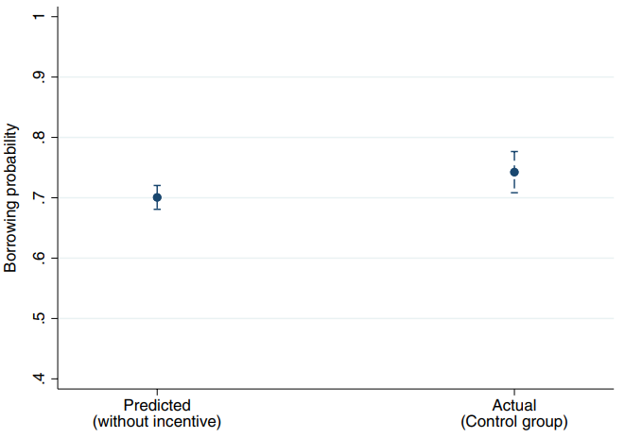
Alcott, et al.
70% of borrowers predicted they would reborrow, in fact 74% did=statistically identical: “This implies that the average borrower almost fully anticipates repeat borrowing.”

Slide 42
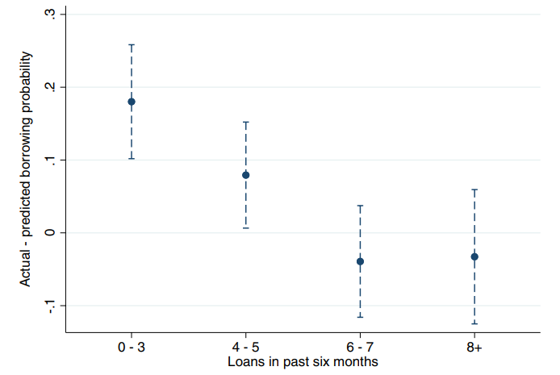
Alcott, et al.
Accuracy increases with experience

Slide 43
Default
Theory of Rational Default
Consequences of Default?
Credit reporting: No
Collection: Rarely
Lawsuits: Even more rare
They have no money!
Access to future loans:
Large number of defaults make zero or one payment: Strategic Default
No evidence whether longer rollover sequences default more often

Slide 44
Auto Title Loans: CFPB
Do consumers underestimate likelihood of revolving: Optimism Bias
Do they understand the risk of repossession on default and the consequences?
“Salience” of default

Slide 45
Auto Title Loans: Hawkins
Predicted and Actual Payoff

Slide 46
Repossession
8.5% say that if couldn’t title pawn would have to sell car to get cash
100% risk of losing car
Hawkins (surveying state studies): Default rate of 8-10% and repo rate of 4-6% (lower than those who would have to sell car)
CFPB:
6% default per loan, 3% repo per loan
33% default per loan sequence, 20% repo
Approx. 83% have more than one loan in sequence
70%-80% have more than one car
Half of defaults do not lead to repossession (higher some places)
Otherwise nonrecourse
Hawkins: consumers say would not prioritize their auto-title pawn payments over their basic necessities such as rent, utilities, groceries, or medical expenses

Slide 47
Why Consumers Use Auto Title Loans
Hawkins (2012): reason why consumers enter into auto-title pawns is to meet urgent and important expenses, such as car repairs, “unusually high utility bills,” to prevent foreclosure or eviction from their home, or to deal with an unexpected medical emergency
20% for rent, 19% for utilities, 17% used loans for car repairs
almost 18 percent of consumers would pay a late fee and almost 9 percent would take a credit card cash advance if no auto title loans

Slide 48
Other Transportation to Work
Hawkins, et al. (2013)
Do not work outside the home 12.16%
Use public transportation 14.14%
Use another vehicle I own 40.20% (usually old cars)
Walk to work 8.93%
Get rides from friends/family 17.37%
Buy a new car 8.68%
No other way to work 14.64%
So depending on repo rate of functioning cars, about 1% might lose only way to work (Hawkins): 14.6% * repo rate
Ex: 20% default * 50% repo rate * 14.64% no other way to work=2%
Remember Alternative
8.5% said they would have to sell their car
17% need title loan to make car repairs

Slide 49
Problem 11.1: Abusive
Unfair—also “abusive”?
5531(d)(2)(A): “takes unreasonable advantage of a lack of understanding on the part of the consumer of the material risks, costs, or conditions of the product or service”
Burying upfront mandatory fees in small print?
5531(d)(1): “materially interferes with the ability of a consumer to understand a term or condition of a consumer financial product or service”
Seems misleading in that interferes with ability of consumer to understand terms and is material because affects price
Abusive as “deception plus”?
Here the lack of understanding caused by covered person’s behavior
Compare Cash Call where lack of understanding was just about consumer’s ignorance

Slide 50
Problem 11.2: Abusive
5531(d)(2)(A): “lack of understanding on the part of the consumer of the material risks, costs, or conditions of the product or service”
subjective versus objective
Focus on monthly payments vs total costs
5531(d)(2)(B): “inability of consumer to protect the interests of the consumer in selecting or using a consumer financial product or service”
“Desperate” consumer
Is this the only competitor? So can’t bargain?
Williams v. Walker-Thomas
5531(d)(2)(C): “reasonable reliance by the consumer on a covered person to act in the interests of the consumer”
Can consumer have reasonable reliance on a used car dealer to act in their interest?
“Unfairness plus”: Cost-Benefit Analysis?

Slide 51
Problem 11.3: Abusive
Reordering overdrafts
5531(d)(2)(a): “taking unreasonable advantage of lack of understanding of the consumer regarding the material risks, costs, or conditions of a financial product”
Do consumers understand relationship between reordering overdrafts and total overdrafts?
Cost-Benefit to consumer or other consumers?
Note that Abusive does not seem to contemplate a cost-benefit analysis: Trump I CFPB issued Policy Statement requiring weighing of benefits (like unfairness)

