Slide 1

Class 2:
Substantive and Disclosure Regulation
Presented by
Todd J. Zywicki
George Mason University Foundation Professor of Law

Slide 2
Two Approaches to Regulation
Substantive Regulation: Dictating terms and product design
  Usury ceilings
  Limits on other terms: default, collections, fees
  Mandatory pre-dispute arbitration
  Small-dollar lending rule underwriting model
  Credit Care Late Fee Rule
  Overdraft Protection
Disclosure Regulation
  Truth in Lending: APR
  ATM Fees
How to choose: What is the nature of the market failure and what is the correction
Rationales for substantive regulation
  Externalities
  Market Power
Disclosure Regulation
  Information Asymmetries

Slide 3
Substantive Regulation: Usury Ceilings
History
Religious Limits
Evasions: Money changing
Interest Group Explanations
  Church Borrowing
  Subsidy to wealthier and property classes

Slide 4
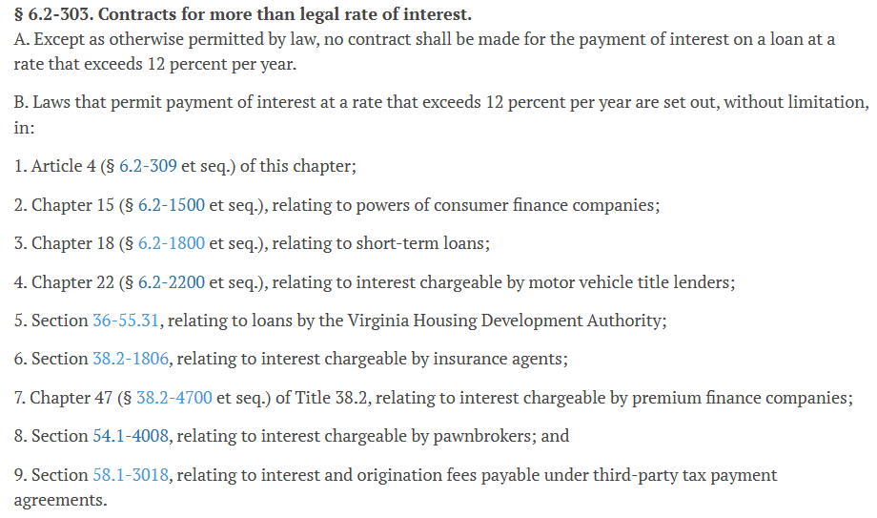
Virginia 6.2-300 “Interest and Usury”

Slide 5
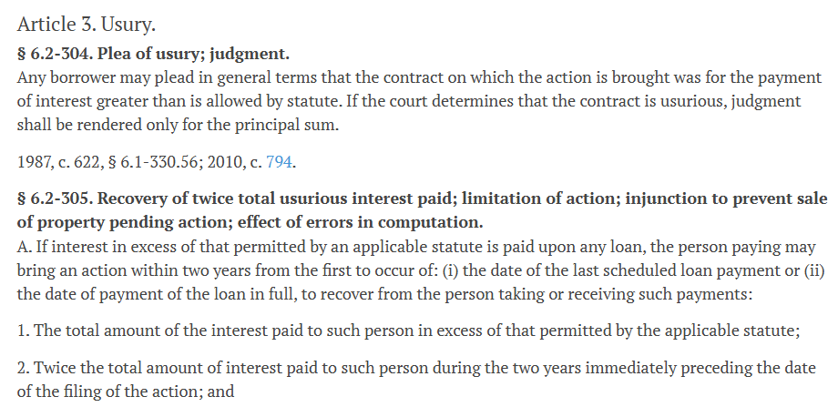
Remedies

Slide 6
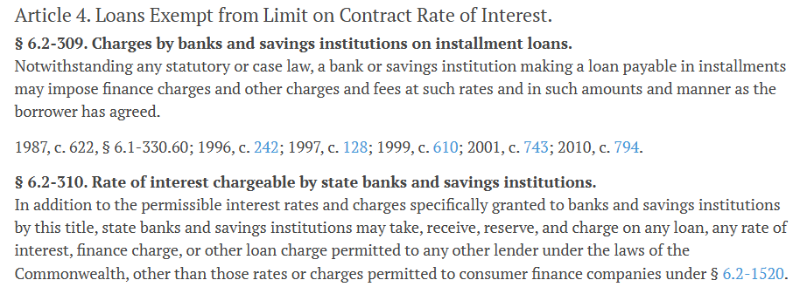
Usury Exemptions

Slide 7
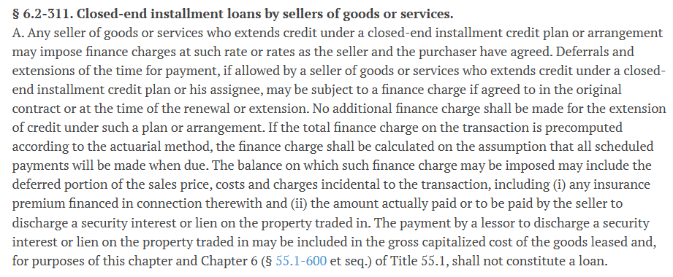
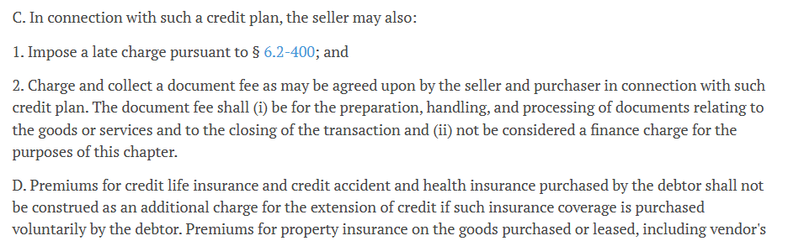
Seller Finance

Slide 8
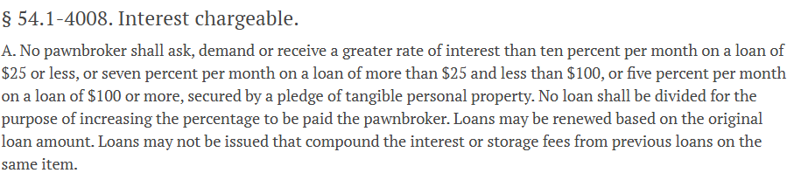
Pawnbroker

Slide 9
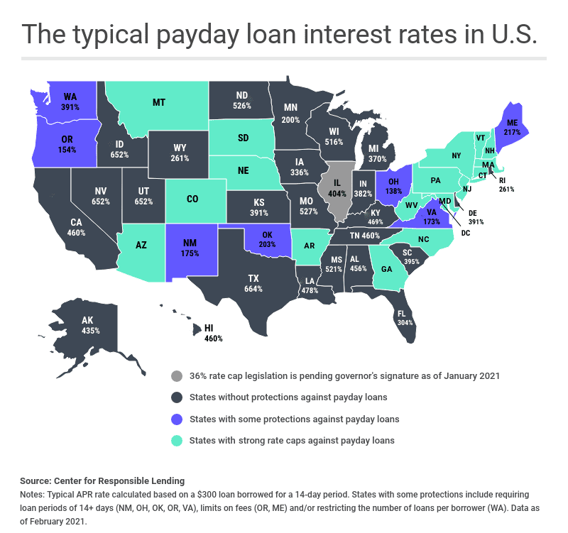
Payday Loan Rates

Slide 10
Criticisms of Usury Ceilings
Autonomy: Freedom of contract and externalities spurious
Arbitrariness: How is credit any different from other products
  Car loans: Limit price of loan but not price of car?
  NCCF (p. 3): Commission cannot “say that the price or hamburger or shoes was ‘fair’ at any given time, or that more of either might be better. IN almost all instances in our economic system we look toward a marketplace. If sufficient alternative sources compete for patronage, it is assumed that the price and supply are ‘far’, because they are set by free competitive forces.”
  “the essentials of how much credit, to whom, and at what price should be left to the free choice of consumers in the marketplace—provided that the marketplace is competitive.”
  Focus on market failures
Unintended Consequences

Slide 11
Substantive Regulation
Have to price risk or reduce risk exposure
Effect of Regulation: Intended Consequences
Effect of Regulation: Unintended Consequences
  Term Substitution/Repricing
  Product Substitution
  Rationing
  Dynamic Effects and Competition

Slide 12
Term Repricing
Interest Rate
Annual Fee
Fees: Late Fees, Cash Advance Fees, etc.
Benefits
Loan Amount
Downpayment
Security
Co-Signer
Default Terms
Customer Service/Hours

Slide 13
Term Repricing
Usury Laws and Annual Fees
  Consumer Welfare: Consumers Hate Annual Fees
  Dynamic Effect: Competition and Card-Switching
Retail Stores
  Price of Appliances
  “Banker’s Hours”
  Gift Wrapping

Slide 14
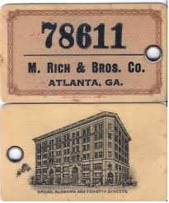
Product Substitution: Retail Credit
Arkansas v. Higher-ceiling states (Dunkelberg & DeMagistris, 1979):
49% of credit in Arkansas retail versus 29% (Wisconsin, Louisiana)
Banks/finance cos./credit unions: 41% in Arkansas versus 67% elsewhere
28% in Arkansas turned down for credit
versus 12% in LA (no ceiling)
Ark consumers more likely to say retailers
easiest place to get credit

Slide 15
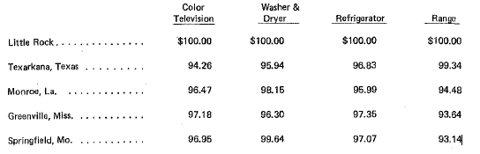
How Retailers Adjust: Why?

Slide 16
Product Substitution: Car Loans
Melzer & Schroeder (2017): What happens when usury restrictions bind on car loans?
Dealers finance larger percentage of car loans, especially among riskier borrowers—Why?
  Interest rates for dealers lower but size of loan and LTV increases
  Average loan size by non-dealers declines
  Loan to value ratio increases by 40 to 60 percentage points: Dealers markup price of the car to offset the inability to charge market price
Overall effect of tradeoff between reduction in interest rate and increase in LTV results in increase in monthly payment on net
  Reduces competition because non-dealers can’t compete
  Higher LTV and larger loans increase liability on default

Slide 17
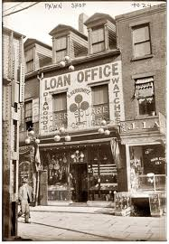
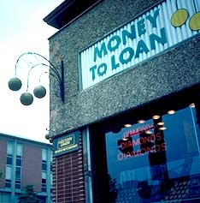
Product Substitution: Pawn Shops—Why?
.

Slide 18
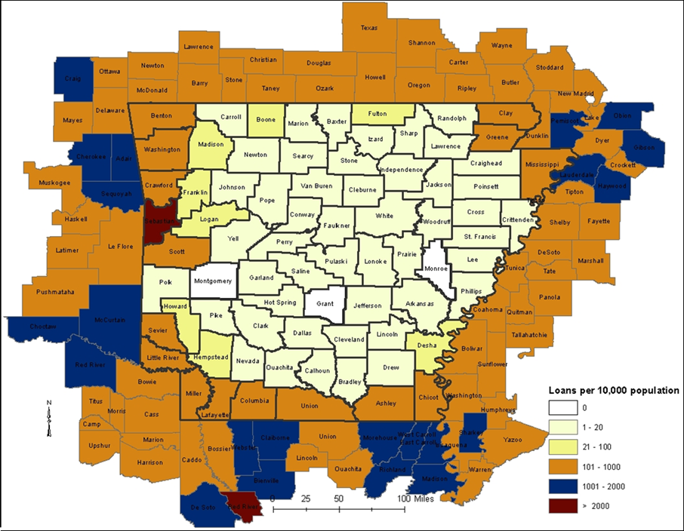
Searching for Credit (Miller)

Slide 19
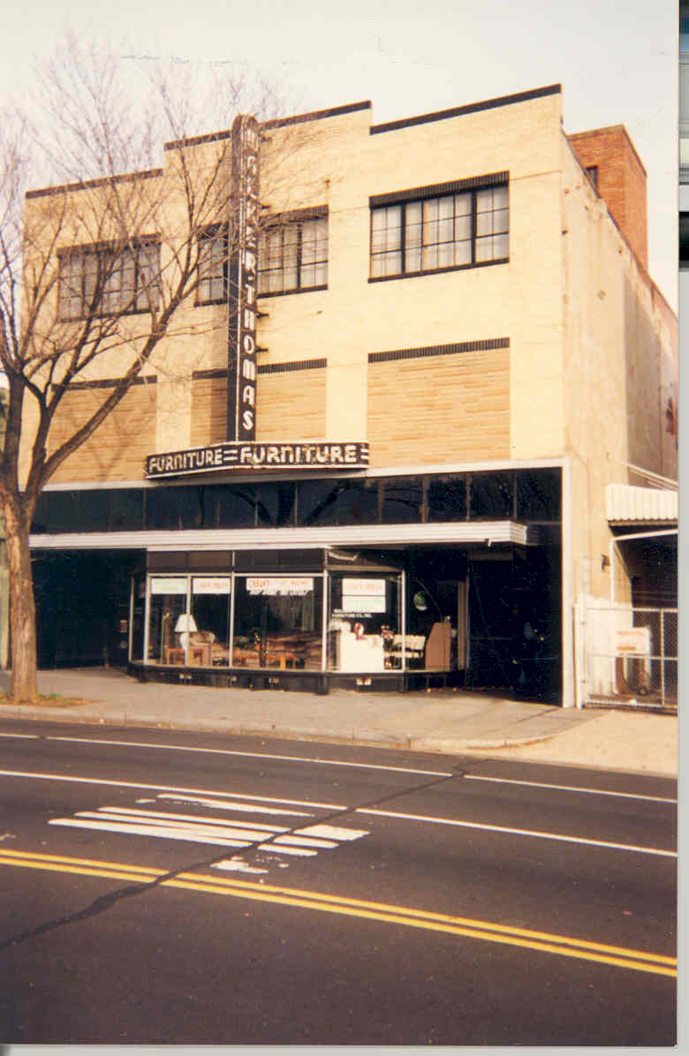
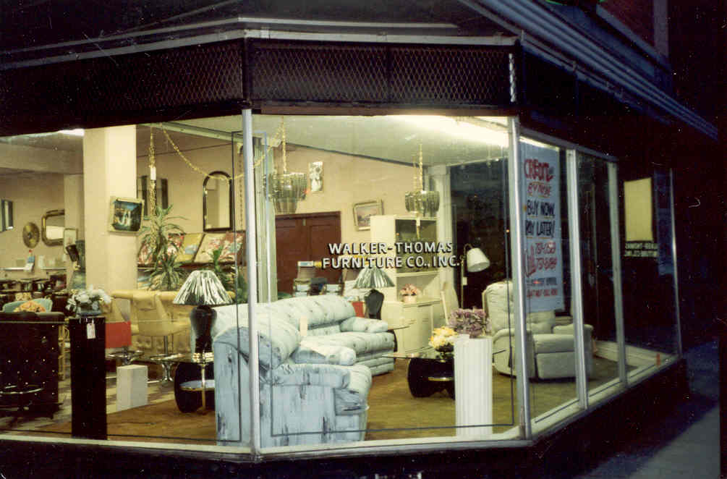
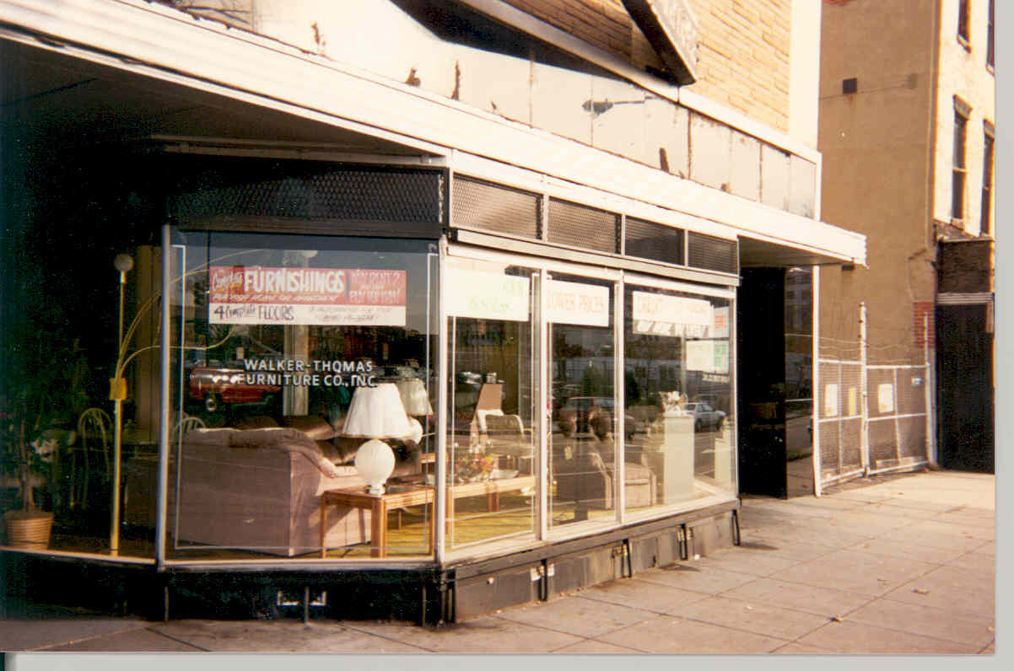
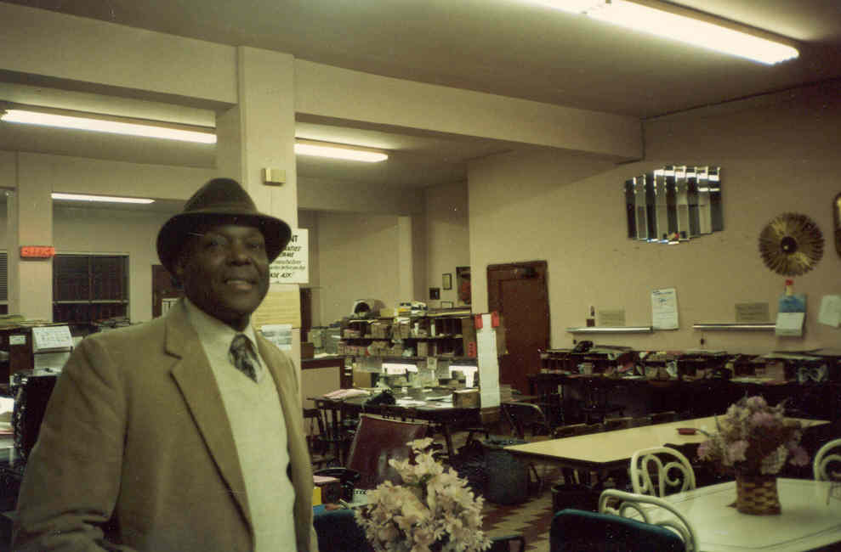
Implications for Law: Williams v. Walker-Thomas Furniture

Slide 20
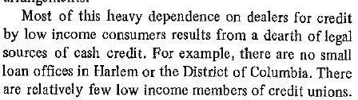
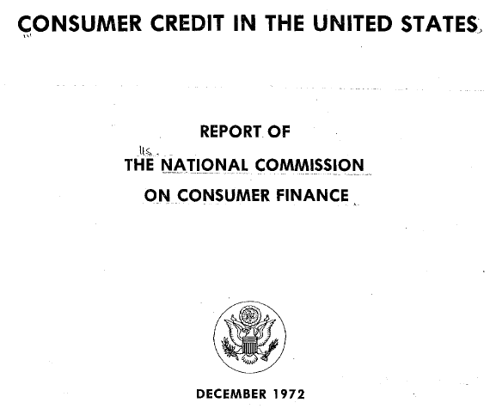
Why would Ms. Williams Shop There?

Slide 21
Loan Sharks: Return Later in Semester
U.S. Senate, Committee on Government Operations, Subcommittee on Legal and Monetary Affairs, “Federal Effort Against Organized Crime: Report of Agency Operations” (June 1968):
“Organized crime derives most of its revenue from gambling....
“Organized crime’s next largest source of revenue is from “loan sharking” or ‘shylocking,’ that is the lending of money at highly usurious rates of interest, generally in circumstances where the lender is more interested in perpetuating interest payments than in collecting principal; and where force and threats are used to effect collections, to eliminate protests when interest rates are raised, and to prevent the beleaguered borrower from reporting the activity to law enforcement officials.
“The President’s Crime Commission indicated that no reliable estimates exist of the gross revenue that racketeers derive from organized loan sharking but that profit margins are higher than from gambling operations. Many law officials classify the business in the multibillion-dollar range. Gambling profits often are used to “bankroll” loan sharking operations.

Slide 22
Cycles of Consumer Credit Regulation
Early 20th Century
  1911: 35 percent of New York City’s employees owed money to illegal loan sharks
  Alan Greenspan: “virtual serfdom”
Deregulation: Russell Sage Foundation and Uniform Small Loan Law
The Great Depression and the Response
1960s & 70s
  1963 Caplovitz found high level of usage of loan sharks by low income families
2008 and Today

Slide 23
Law of Usury
Marquette and interest rate exportation
Madden
“True Lender”

Slide 24
Effects of Marquette: Credit Cards 1970-2010

Slide 25
Smiley
Late fees also “interest”

Slide 26
Disclosure Regulation: Rationales
Rationales
Not as bad as substantive regulation
Facilitate competition and consumer choice
“Normative Disclosure”
Truth-in-Lending (TILA): First federal regulation

Slide 27
NCCF
Inform consumers to protect themselves against creditor “overreach”
Facilitate shopping, competition, transparency: Russell-Sage
Annual Percentage Rate (APR): All-in price
Apples-to-Apples Comparison
Prior to TILA different disclosure schemes required by states
TILA standardized and improved consumer understanding
Chapter 24

Slide 28
APR
APR = ((Interest + Fees/Loan Amount) / (Number of days in loan term) x 365 x 100
Create Apples to Apples comparison
Online APR Calculator

Slide 29
Purposes of Disclosure
Standardization
Shopping
Too many goals
Updating
Limits

Slide 30
APR Is Not a Price!
Some loans are oranges not apples!
A two-week small-dollar (payday) loan is not the same as a 30 year mortgage
APR accounts for maturity and loan amount
So a more expensive loan can have a lower APR if longer duration or larger amount borrowed
Evasion of Usury Ceilings by forcing borrowers to borrow more or for longer loan period

Slide 31
Economics of Information
Information is not costless
Opportunity Cost
MB>MC
Rational Ignorance
APR can reduce search costs for consumers comparing products
But less useful in comparing different products

Slide 32
Incentives
Consumers have incentive to focus on what matters
  Revolvers shop and know APR
  Transactors shop and know rewards
Sellers have incentive to provide relevant information to consumers
Consumers are heterogeneous
Sellers have incentive to provide negative information about rivals
Markets, common law, and regulation (FTC) can ensure that sellers provide accurate information
Poor regulation can distract and make updating difficult

Slide 33
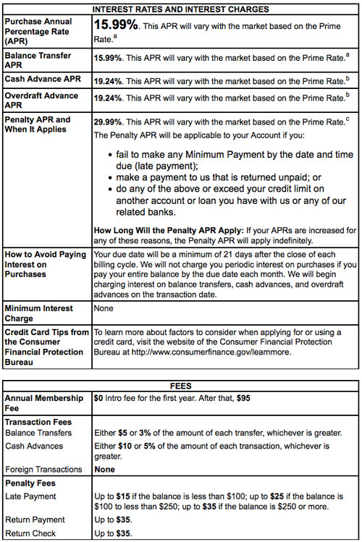
Schumer Box Example

Slide 34
Disclosure: Bank Account
Bank Account Opening
50% Just Right
25% Too Little
25% Too Much

Slide 35
Limits of Disclosure
7 “chunks” of information
Understanding: ALL CAPS
Information Overload
Information Accumulation: Always add, never subtract
Distraction/Displaced Information: YSP
Updating
Information for Information sake
Normative Disclosure
Not everyone needs to know: Marginal Consumer shopping
Misunderstanding
Heterogeneous shoppers:
  2/3 of transactors found credit card disclosures unhelpful
  85% of revolvers thought useful

Slide 36
TILA Evolution
Started at 6 pages
Now 20 disclosures for closed-end
Open-end (credit card) 31 disclosures
Mortgages: 49 disclosures 101 pages

Slide 37
Taskforce Recommendations
Primary goal is shopping: all others subordinate
Consider starting with consumer attention span and the prioritize disclosures
Bundling of information: RESPA closing
Make more flexible and easier to update in the Information Age

Slide 38
APR: Annual Percentage Rate
APR is a “Stated Rate”
“Codified” in the Title I of the Consumer Credit Protection Act, 1968
Title I better known as the “Truth in Lending Act.”
Aim: Force lenders (especially auto lenders) to disclose the cost of the loan.
Right away: Cost ($) confused with Rates (%)
Correct Use of APR
Incorrect Use of APR

Slide 39
Payday Loan Terms:
A Simple Forward Contract
Today: Borrower writes “post dated check” (or sign ACH) to lender for $240.
Borrower receives $200 from lender.
In Two Weeks: Lender cashes check (or hits account via an ACH--Automated Clearing House authorization).
Suppose borrower does not have sufficient funds in account…..
The “APR” is (40/200) × 26 × 100 = 520% (Periodic Rate per period times number of periods times 100)
The cost is $40

Slide 40
The Tale of “APR FEVER”
(This Tale Contrasts Cost and Annual Percentage Rate, APR)
You go to an ATM on Friday and take out $50.
Your bank is not connected to this ATM.
  You will have to pay a fee.
  Suppose the fee is $3.
  This fee and the withdrawal hits your bank account on Monday.
You “borrowed” $50 of your own money for 3 days.
Cost: ($1 dollar per day) = $3
APR: ($1 / $50 times 365 days) = 730%.
On What SHOULD We Focus?
On What DO We Focus?
Notes:
The “A” in “APR” stands for ANNUAL.

Slide 41



Installment Loan Example: Borrow $1,000 for 12 months, rate of 3 percent per month
(APR = 36 percent).
(r and T must agree)
To calculate the loan payment:
In this example, the Present Value Factor is:
The monthly payment, $C, is:
    $C = $100.46.
Total interest and principal = $100.46 × 12 = $1,205.55, i.e., NOT $1,360.
Notes:
This formula is the easiest possible way to calculate an installment payment accurately. NOTE: t and r must match periodicity. If t is in months, r must be the monthly interest rate.
The total of interest and principal payments equals the payment times the number of payments, or $100.46 times 12, or $1,205.55. The consumer borrowed $1,000, so the consumer pays $205.55 in interest over the life of the loan. Notice that the consumer does not pay $1000 times .36, or $360 of interest. The difference between $360 and $205.55 occurs because the amount owed each month declines, or amortizes, over the length of the loan. Therefore, even though the 36 percent interest rate determines the size of the installment payment, the interest income received by the lender is $205.55, or 20.56 percent of $1,000.

Slide 42
Fair or Foul?
Amount Borrowed | Interest Paid | Total Repaid
$9,000 | $5,125 | $14,125
$10 | $4.40 | $14.40
$40,000 | $10,400 | $50,400
$300,000 | $347,515 | $647,515
$300 | $60 | $360
$1,000 | $440 | $1,440
$5 | $1 | $6

Slide 43
Fair or Foul?
Amount | Interest Paid | Total Repaid | Term | “APR” | TIP | Product
$9,000 | $5,125 | $14,125 | 7 years, monthly payments | 14% | 0.57 | Used Auto
$10 | $4.40 | $14.40 | 6 weeks, weekly payments | 600% | 0.44 | 1910 Loan Shark
$40,000 | $10,400 | $50,400 | 6 years, monthly payments | 8% | 0.26 | New Auto
$300,000 | $347,515 | $647,515 | 30 years, monthly payments | 6% | 1.16 | Mortgage
$300 | $60 | $360 | 2 weeks, single payment | 520% | 0.20 | Payday
$1,000 | $440 | $1,440 | 1 year, monthly payments | 72% | 0.44 | Installment
$5 | $1 | $6 | 1 day, single payment | 7,200% | 0.20 | “Cafeteria Table”

Slide 44
APR v APY (Annual Percentage Yield)
APR =annualization of the finance charge as a percentage of the original loan balance
APY = interest that gets added to the original balance like on a CD—you get paid interest on your interest

Slide 45
Truth in Lending
Statute: 15 U.S.C. 1601
Regulation Z: 12 C.F.R. Part 1026
Regulatory Supplement, Official Interpretations (example p. 388 of code)
Official Staff Commentary
Official Forms
Appendix

Slide 46
TILA
Who Must Disclose? “Creditor”: 15 USC 1602(g)—“a person who both”… “regularly extends… consumer credit which is [1] payable in more than four installments or [2] for which the payment of a finance charge is or may be required.”
  [2] is general rule. But if more than four installments, TILA conclusively presumes there must be a finance charge with interest “baked into” price of goods
  Buy Now, Pay Later is 4 payments and no finance charge

Slide 47
TILA
What must the creditor disclose? 15 USC 1638 (other than open-ended)
  “Amount financed”
  “Finance Charge”: 15 USC 1605: sum of amount financed + all charges imposed directly or indirectly or as incident to the extension of credit
    Need not disclose charges of a type payable in a comparable cash transaction
    Do not have to disclose fees paid to third-parties if creditor does not require imposition of the charges and does not retain the charges
    12 CFR 1026.4(a): “Finance charge”: “the cost of consumer credit as a dollar amount”
    12 CFR 1026.4(a)(1)(ii): Charges for third parties if retain some of fee
    12 CFR 1026.4(b)(8): Certain insurance premiums, i.e., “credit life”
    15 USC 1605(a) includes: points, service charge, loan fee, credit report fee, credit insurance, mortgage broker fee
  “Annual Percentage Rate”: 12 CFR 1026.22 (discussed above)
  Similar rules for open-ended/credit cards: 15 USC 1637

Slide 48
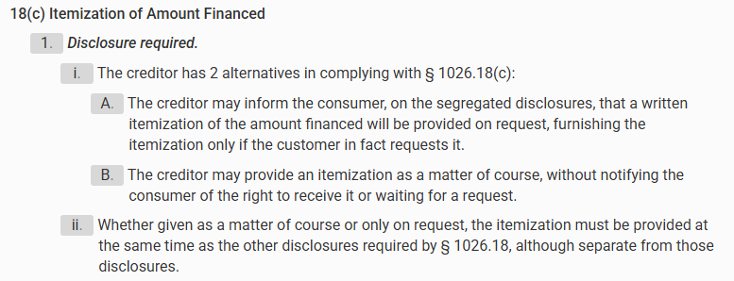
Gibson v. Bob Watson Chevrolet (p. 481)
Class action under TILA
Car loan: closed-end installment credit
15 USC 1638(a)(2)(B): if consumer makes written request, creditor shall provide certain itemized costs, including “amount paid to third persons by the credit on the consumer’s behalf” (idea seems to be so consumer can shop around for option products)
12 CFR 1026, Supp. I §18(c): Itemization of Amount Financed https://www.ecfr.gov/current/title-12/chapter-X/part-1026/appendix-Supplement%20I%20to%20Part%201026 :

Slide 49
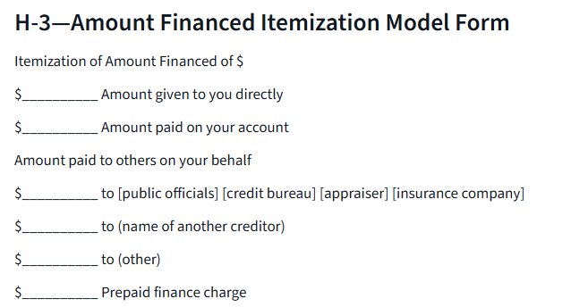
Here
Bob Watson voluntarily disclosed it: 18(c)(1)(b)
Problem is that Bob Watson disclosed it inaccurately—implied it was paying $800 to the third-party when in fact it was keeping some of the $800
Defendant says that just because it discloses it is paying some of the $800 to the third-party it doesn’t have to disclose that it is keeping some
2d defense: Says they complied with 12 CFR 1026, App. H-3 (form 14-3): https://www.consumerfinance.gov/rules-policy/regulations/1026/h/#d0fcae392fe57e34ea93edddae2c6fa70213fcc1ea738ac58b37524f
Safe harbor if did

Slide 50
Harm to Plaintiffs
Unclear: District Judges might think “plaintiff’s law firm is harassing Chicago-area automobile dealers with complaints about purely technical violations of a highly technical and much-criticized statute,” i.e., the $800 was disclosed is there really any harm from not disclosing that the cost of the extended warranty was not the full $800?
Maybe. Policy logic:
  If actually knew that not all the money going to insurer might shop around more
  Or might haggle if knew the cost not dictated by third-party
Notes anomaly that cash purchasers might have paid for same thing but have no rights
Unless this is added-on or more expensive for credit transactions than cash
  Note that if the price for the add-on is not systematically more expensive for credit than cash purchasers then might not be a finance charge at all so wouldn’t have to be disclosed: 15 USC 1605(a)

Slide 51
Problem 24.1.a. (Page 491)
What can Odinet do?

Slide 52
Problem 24.1.a.
He can try to avoid being classified as a “creditor”—15 USC 1602(g): i.e., A creditor if (1) fewer than four installments or (2) finance charge
  4 installments, no finance charge, but a late fee: 12 CFR 1026.4(c)(2)
  Application fee—12 CFR 1026.4(c)(1)), fee for participation in a credit plan (i.e., annual fee)—12 CFR 1026.4(c)(4)

Slide 53
Problem 24.1.b.
Could it still be subject to CFPB Authority?

Slide 54
Problem 24.1.b.
CFPB has authority over TILA as enumerated but CFT has other powers and can impose additional disclosure for products beyond TILA 12 USC 5532

Slide 55
Problem 24.2
What is her APR on this open-ended credit?

Slide 56
Problem 24.2
$20/$1000 balance= $20/$1000 * 365/30 = 24.3 APR

Slide 57
Problem 24.3.a.
What do you tell him about whether he must disclose the following types of charges?
Interest on the loans?

Slide 58
Problem 24.3.a.
12 CFR 1026.4(b)(1): Of course interest is include in the finance charge. The quintessential finance charge—a cost for borrowing funds.

Slide 59
Problem 24.3.b.
Charge for a credit report?

Slide 60
Problem 24.3.b.
Charge for a credit report?
Yes, if a charge that only applies to a credit buyer not a cash buyer (presumably not)
12 CFR 1026.4(b)(4)

Slide 61
Problem 24.3.c.
Single-payment credit life insurance—if he dies the loan is forgiven.
Must this be disclosed?

Slide 62
Problem 24.3.c.
Generally considered a finance charge and required to be disclosed: 12 CFR 1026.4(b)(7)
But can be excluded under 12 CFR 1026.4(d)(1) if
  Not required by creditor
  If premium disclosed in writing
  And consumer files an affirmative written request for the insurance after receiving the disclosure
  Also credit accident, health, or loss-of-income insurance
  Note: If do this then must still be disclosed separately, just not a finance charge so not part of APR
  If it is required then it is part of the cost of the loan so part of APR
Why do creditors come up with these sorts of weird products and sell them with the loans?

Slide 63
Problem 24.3.d.
$30 fee to record the lien on the car even though recording office only charges him $20?

Slide 64
Problem 24.3.d.
12 CFR 1026.4(b)(4): must include “appraisal, investigation or credit report fee”
But “lien recording fee” is for recording, not investigation in connection with extending credit
But it is a fee charged only to a credit consumer not a cash consumer so presumptively a finance charge
May still be excluded under 12 CFR 1026.4(e)(1) for certain “security interest charges” but only to the extent of $20 because that’s not a fee for the creditor.
The $10 for his time and trouble to record the lien is part of the finance charge so $10 of the $30 must be included

Slide 65
Problem 24.3.e.
$35 late fee?

Slide 66
Problem 24.3.e.
No: 12 CFR 1026.4(c)(2) if for “actual unanticipated late payment”
Will have a question later in the semester where it is expected borrower will pay late

Slide 67
Problem 24.3.f.
3% discount on purchase price of car if down payment made in cash or by check?

Slide 68
Problem 24.3.f.
12 CFR 1026(c)(8): “Discounts offered to induce payment for a purchase by cash, check, or other means”
2 CFR 1026(b)(9) says discounts for the purpose of inducing payment by a means other than the use of credit counts as a finance charge, (c)(8) overrides that.
  Any discount that results in a higher price for credit users is usually considered a finance charge
The bracketed material in (c)(8) that is lifted from 15 USC 1666f indicates that this is permissible only for a credit card purchase so would not apply here to an auto loan
  This exception comes from the Cash Discount Act which requires credit card issuers to allow merchants to offer cash discounts on credit cards

Slide 69
Problem 24.3.g.
“Dealer excess reserve”—a markup of 5% on all cars on which he does not provide the financing?

Slide 70
Problem 24.3.g.
Now there’s an extra charge on two groups: cash sales and those who finance through third-party credit (although those are identical from the perspective of the seller)
Is there a TILA issue here? No. Not charging more for credit actually charging more for cash and third-party financing.

Slide 71
Problem 24.3.h.
$50 “processing fee” for offering indirect financing through International Automotive Acceptance Corporation. He keeps $40 and remits $10 to IAAC. What does he have to disclose?

Slide 72
Problem 24.3.h.
The $10 that goes to IAAC must be disclosed because it is part of the “cost of credit.”
The $40 he keeps as a “processing fee” (essentially a brokerage fee) is not part of the “cost of credit” so it doesn’t have to be included in the finance charge
12 CFR 1026.4(a)(1)(ii): because he keeps some of the fee, he has to disclose the amount to IAAC
For some reason, if he was a mortgage broker, the entire amount would be included

