Slide 1
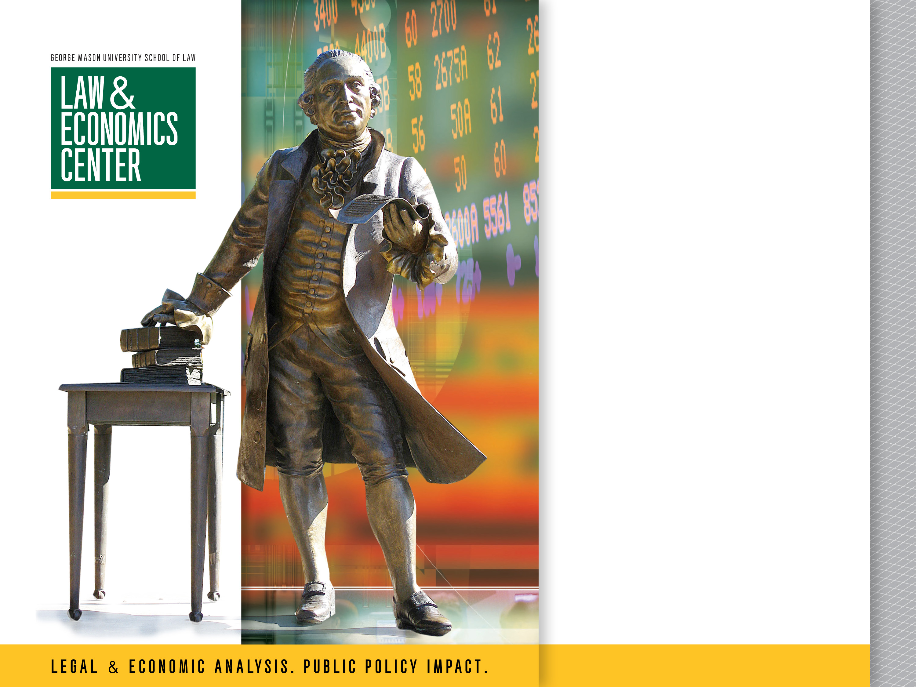
Class 1: Introduction and Origins of CFPB
Presented by
Todd J. Zywicki George Mason University Foundation Professor of Law Senior Fellow, Cato Institute

Slide 2
“The Great Tempter”
“Credit is the latest ally of the devil. It is the great tempter. It is responsible for half the extravagance of modern life. The two words ‘charge it’ have done more harm than any others in the language. They have led to a vast amount of unnecessary buying.”
New York Times
“Americans are running in debt.”
Americans are “borrowing trouble.”
“Is the Country Swamped with Debt?” (Business Week)
“Never Have So Many Owed So Much.” (U.S. News and World Report)
“The luxuries of the last generation are deemed to be necessities… The person who can’t pay… is nevertheless assured by high pressure sales talk that he can do so by easy weekly or monthly payments which only come to a few cents a day.” (Commercial Law Journal)
“Conspicuous Consumption”
“Concern has been expressed that the burden of consumer indebtedness is becoming so excessive as to constitute a threat to the stability of the economy.” (Southern Economic J.)

Slide 3
“The Great Tempter”?
“Credit is the latest ally of the devil. It is the great tempter. It is responsible for half the extravagance of modern life. The two words ‘charge it’ have done more harm than any others in the language. They have led to a vast amount of unnecessary buying.” Charge It (Irving Bacheller, 1912)
New York Times
“Americans are running in debt.” (1873)
Americans are “borrowing trouble.” (1877)
“Is the Country Swamped with Debt?” (Business Week 1949)
“Never Have So Many Owed So Much.” (U.S. News and World Report 1959)
“The luxuries of the last generation are deemed to be necessities… The person who can’t pay… is nevertheless assured by high pressure sales talk that he can do so by easy weekly or monthly payments which only come to a few cents a day.” (Commercial Law Journal 1963)
“Conspicuous Consumption” (Veblen 1899)
“Concern has been expressed that the burden of consumer indebtedness is becoming so excessive as to constitute a threat to the stability of the economy.” (Southern Economic J. 1974)

Slide 4
The Good Old Days
Elizabeth Warren (2004): “The [credit card] industry has no evidence that people were being turned down for loans in the early 1980s. What they have is evidence that people more often in the early 1980s preferred to pay cash than to pay on credit.”

Slide 5
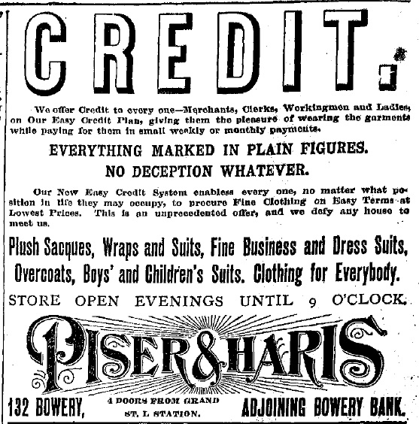
“Easy Credit” (NY World Oct 1888)
.

Slide 6
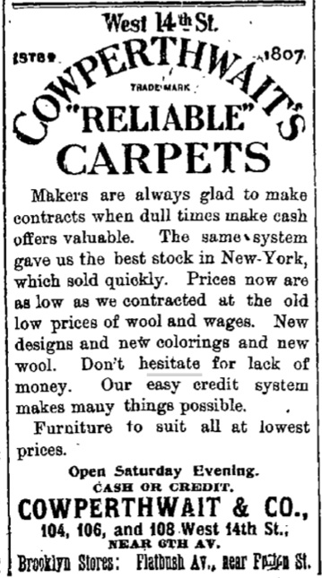
“Easy Credit” (NY Times, Oct 1895)
.

Slide 7
Retail Store Credit
1900-1939: total consumer nonmortgage installment debt quadrupled in real dollars, increasing 2-1/2 times during the decade of the 1920 alone.
1930s: majority of sales of household furniture, appliances, radios, cameras, and jewelry were credit sales, as were a substantial percentage of rugs, hardware, sporting goods, and books, such as encyclopedia and other book sets. Pianos and sewing machines.
David Caplovitz (1963) study of low income households: 75 to 90 percent of their sales on installment credit. Two-thirds of families who relocated into public housing projects in the 1960s purchased their new furniture and major appliances on credit.
More than 70 percent of households used credit to purchase a television set and that lower and higher-income families were just as likely to use credit.
Caplovitz found that 81 percent of low-income families in his study used credit
FTC (1968): 93% of household goods sales to low-income households on credit
Retailers required that consumers make weekly or monthly payments: Forced consumers to visit the store to make payments so retailers could sell still further goods and put the consumer into still further indebtedness.

Slide 8
Criticisms of Installment Credit
Installment selling was criticized for allegedly inducing overconsumption by American shoppers, especially supposedly vulnerable groups such as “the poor, the immigrant, and the allegedly math-impaired female.”
Rapacious installment sellers were accused of extending credit to unworthy borrowers, leading them to purchase unnecessary products and generating debts beyond their means to repay.
Department stores were criticized for “actively goad[ing] people into contracting more debt.”
An 1899 report concluded that installment selling “‘lured thousands to ruin’ encouraging people to buy what they could not pay for and making debt ‘the curse of countless families.’”
1931 Report to the President: “The situation is well illustrated in the case of wage earners who, in large numbers, seek discharge from their debts in bankruptcy because they have been induced by one group of creditors at the expense of another to buy luxuries which they cannot afford.”

Slide 9
Why Businesses Use Credit
Capital Goods
Smooth Revenues and Expenses
Incentives and Agency Costs

Slide 10
Why Consumers Use Credit
Capital Goods
Houses
Student Loans
Cars
Consumer Durables
Smooth Income and Expenses
Incentives: “The Discipline of Debt”

Slide 11
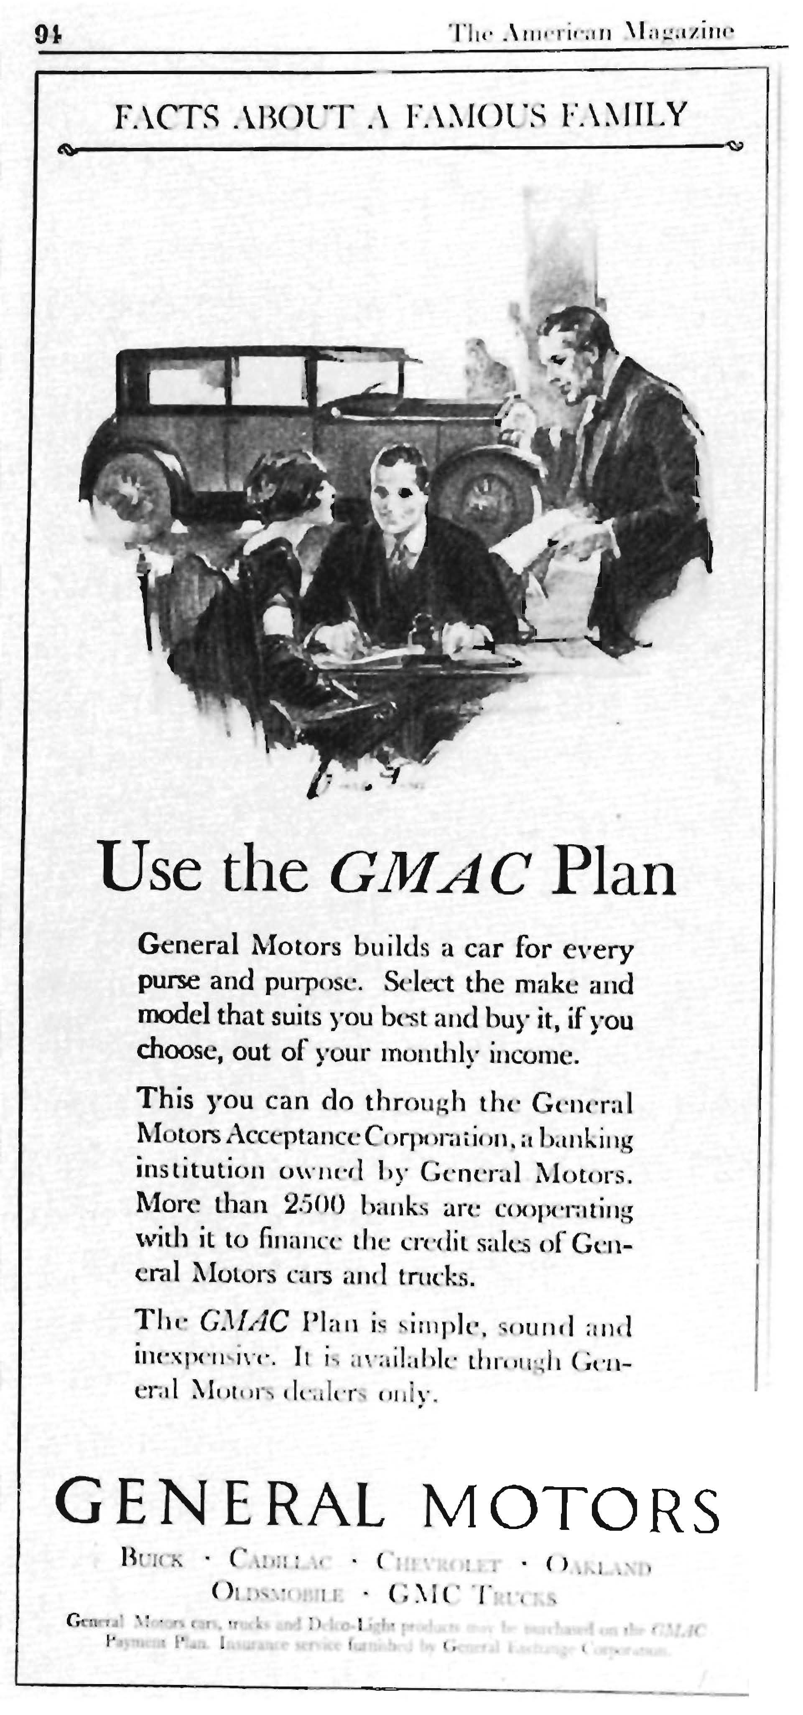
GMAC (1925)

Slide 12
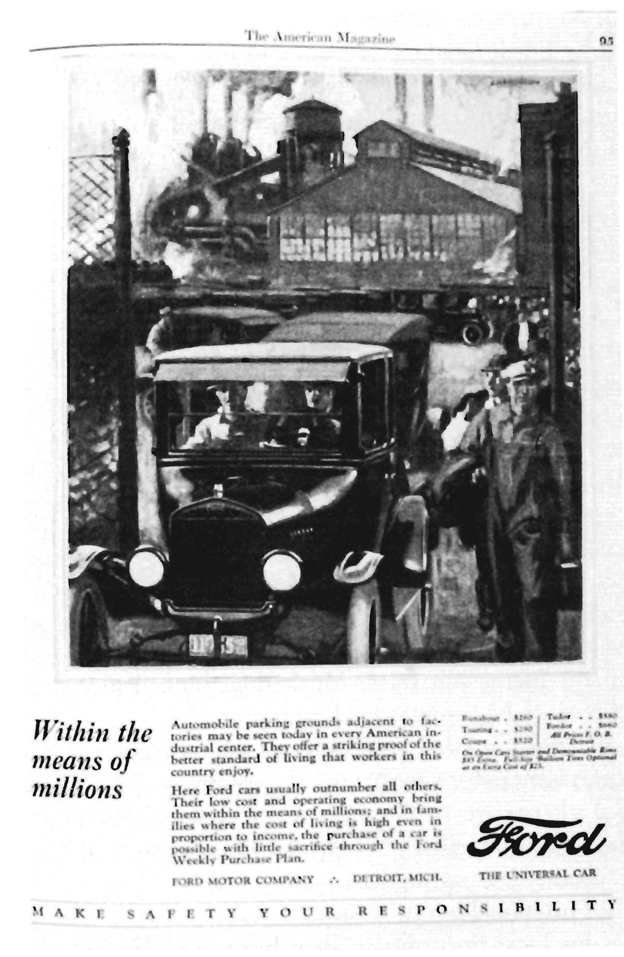
Ford (1925)

Slide 13
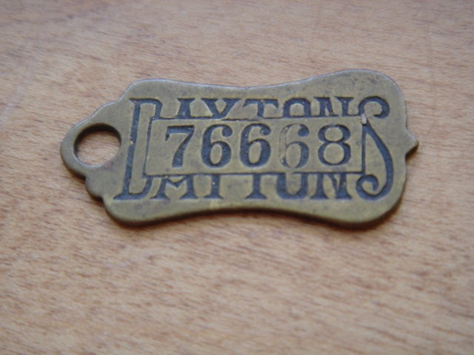
Department Stores

Slide 14
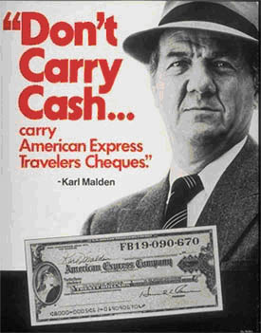
Who is That Guy?
.

Slide 15
Credit Card Ownership: 1970-2010

Slide 16
Credit Card Substitution

Slide 17
Effect of Suburbanization

Slide 18
Growth of Installment Credit

Slide 19
Consumer Satisfaction and Use
Canner and Elliehausen (2013)
82% say credit cards make “managing finances” less difficult versus 8% say “more difficult” (was 72% and 10% in 2001 survey)
Revolvers more likely to say that credit cards make managing finances less difficult (85% vs 80%)
95% “generally satisfied” (51% “strongly”) in dealings with credit card companies v 5% “dissatisfied” (1% “very”)
93% agree that credit card companies “treat them fairly” and 7% disagree
89% of those who had “adverse experiences” with cc companies agree that companies “treat them fairly”
92% say “can easily get a credit card from another company if they are not treated well” (57% strongly agree) vs 8% disagree (2% strongly disagree)
% who paid latest statement “balance in full” 35% in 2000 vs 50% in 2012
% who “usually pay in full” 50% in 2000 vs 62% in 2012

Slide 20
“Other Guy”
49% disagree (21% “disagree strongly”) that “most people are generally satisfied in their dealings with credit card companies” vs 50% agree (only 9% “agree strongly”)
39% agree that “consumers would be better off if there were no credit cards” (14% “agree strongly”)
53% “credit cards make managing finance easier for others” and 40% say more difficult for others (2000 survey)

Slide 21

The Three Legged Stool of Consumer Protection
Find the Optimal Mix to maximize consumer welfare
e Regulation
Common Law
Markets and Competition

Slide 22
Competition and Free Markets
Free Enterprise is organizing principle of economy
Why? Because believe that it delivers the maximum overall benefit to consumers in terms of choice, quality, price, innovation
Allows optimal tailoring for consumers and individual choice and autonomy
But also provides consumer protection
Competition among competing suppliers usually will increase consumer welfare

Slide 23
Markets and Consumer Protection
Competition
Advertising
Name Brands
Repeat Business
Reputation
Third-Party Information Suppliers

Slide 24
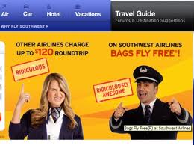
Advertising and Competition

Slide 25

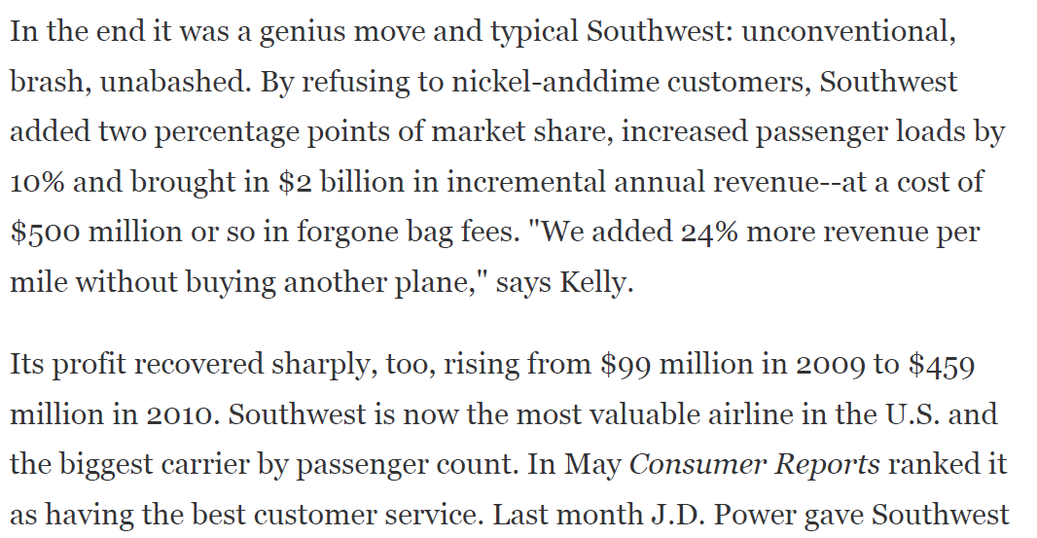
Effects

Slide 26
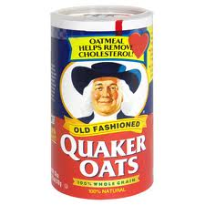
Advertising
From 1978-84, greater evidence of link between high-fiber diet and cancer rates but no shift toward high-fiber cereal
1984: producer health claims in advertising about benefits of fiber
What Happened?

Slide 27
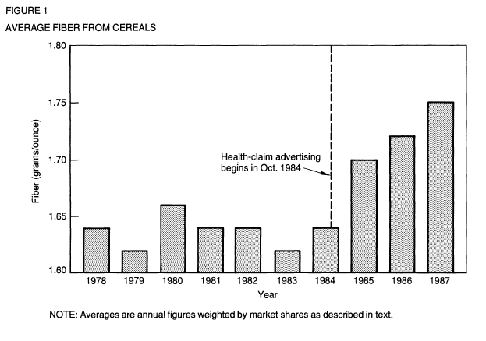
Ippolito & Mathios
Pre-1984: 1.99 grams/oz
Post-1984: 3.59 grams/oz

Slide 28
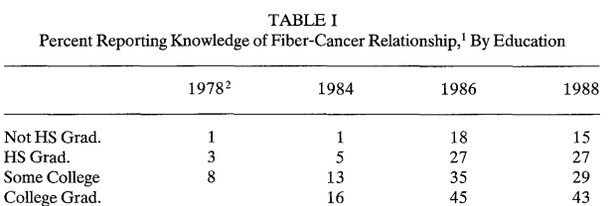
Knowledge by Education Level

Slide 29
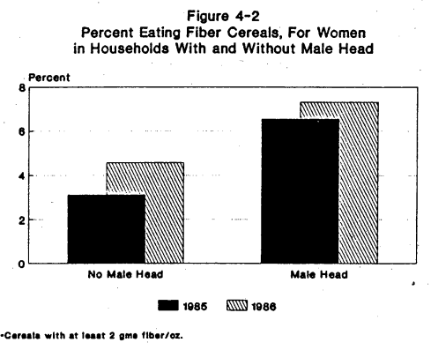
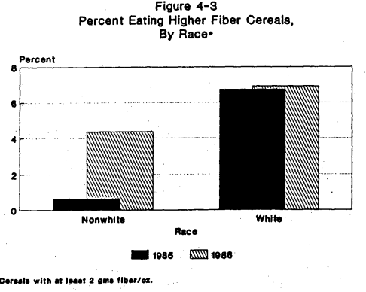
Who Changed the Most?

Slide 30
Effects?
“Even before 1984, firms were permitted to disclose fiber content on cereal labels. Consequently, the dramatic effects on producer and consumer behavior are clearly linked to the use of the health claim rather than the ability to disclose fiber content. In other words, it is important to permit firms to explain the reasons why consumers should care about fiber.”

Slide 31
Name Brands
Klein/Leffler: Investment in a name brand or trademark is like a bond or “hostage”
Can recover investment only if follow through on promises and enough people buy the product
Benefits of long-term repeat customers and reputation exceed benefits of short-term “cheating”
Powerful incentives not to cheat

Slide 32
Brand Names
Loss in stock price from recalls much larger than out-of-pocket costs
1982 Tylenol Poisonings:
Recall cost = $100 million
Loss of stock value = $2.31 billion (29% of J&J Stock Value)
Stock loss recovered in one year
“Crisis in the Cockpit”: stock price falls when airline “at fault” for crash, but not when not at fault

Slide 33
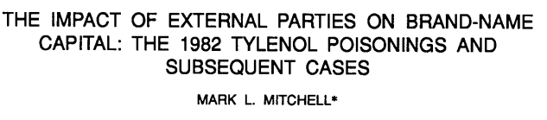
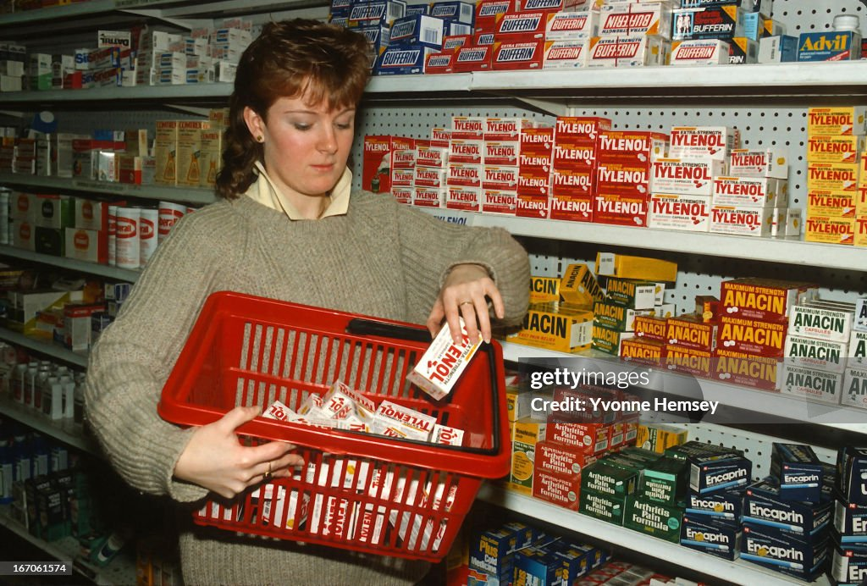
Value of Name Brand
7 Deaths from Cyanide Poisoning
Tylenol Market Share Fell from 35% to 8% in weeks
J&J created tamper-proof packaging and more secure capsules
Out of Pocket Recall Costs: $150 million
Lost $2.11 billion stock value (29% of value)

Slide 34
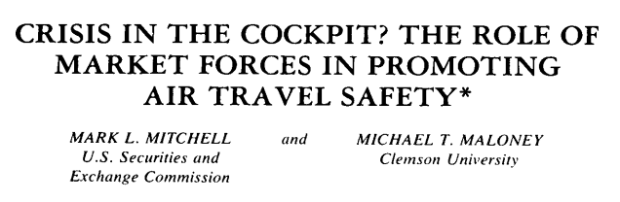
Crisis In the Cockpit?
“[A]irline crashes cause consumers to reduce their demand for the services provided by negligent carriers, which is the prediction of the theory that brand names are a quality assuring mechanism. To summarize the results, in those instances where there is the greatest likelihood that the air carrier is at fault, there is a significantly negative stock market reaction to the event. However, in cases where there is less reason to suspect that the airline shirked its safety responsibilities, there is no adverse stock performance.”

Slide 35
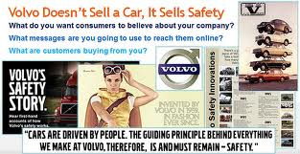
Safe Cars?

Slide 36
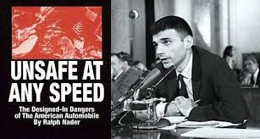
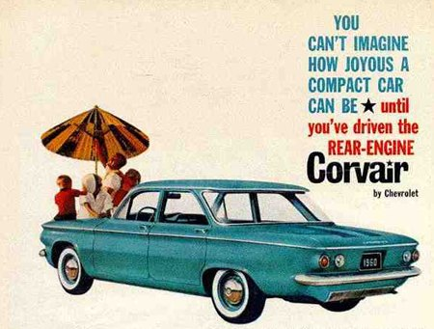
Liability and Regulation

Slide 37
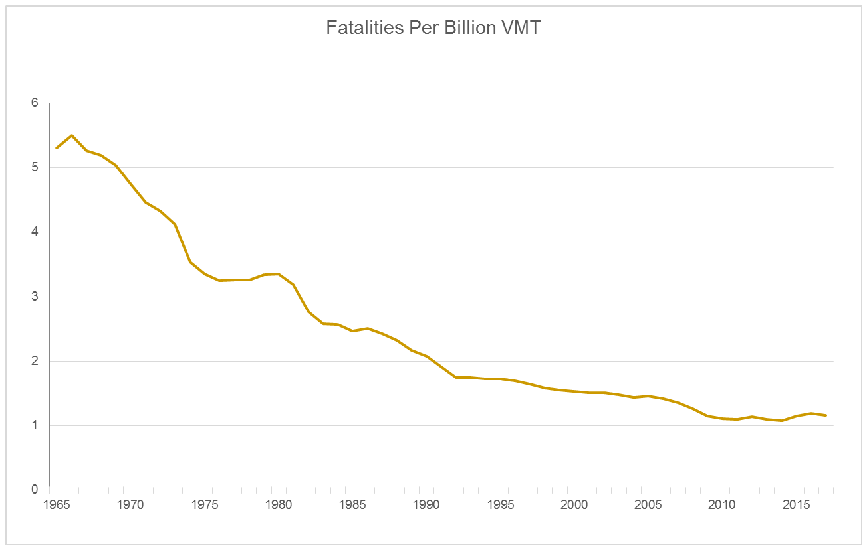
Effects of Regulation?

Slide 38
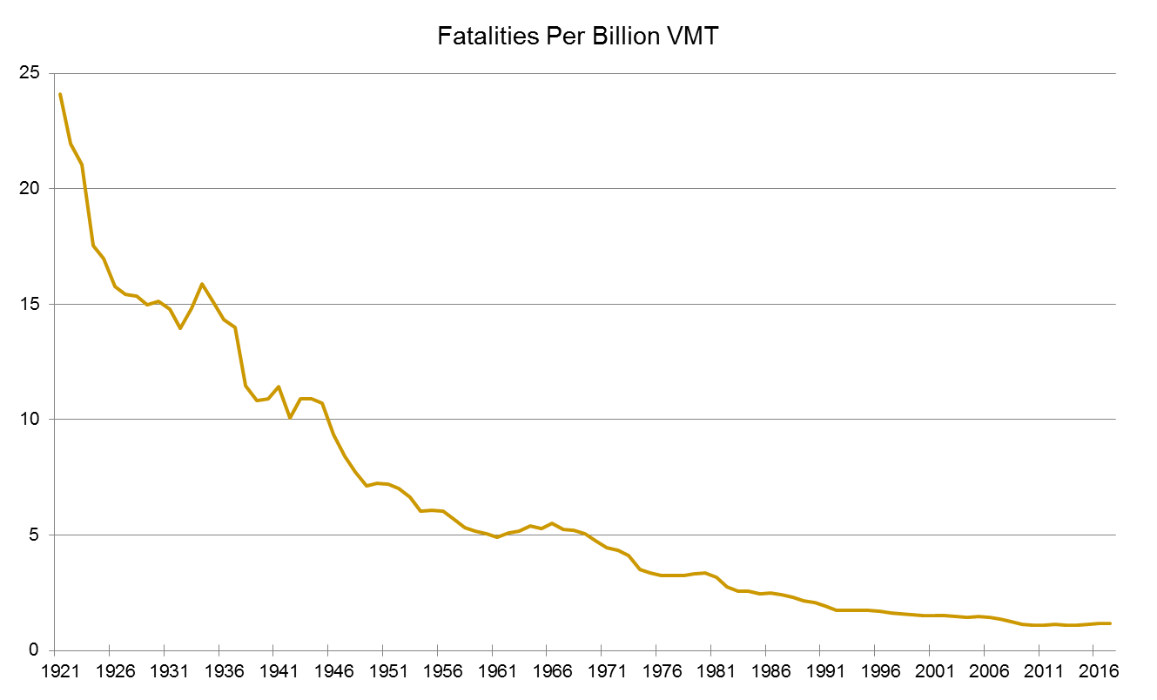
Effects of Competition

Slide 39
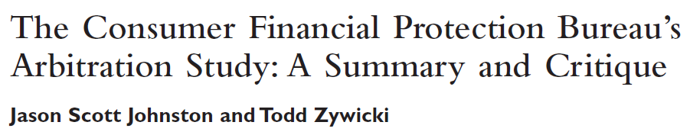
Value of Repeat Dealing/Loyalty
According to CFPB, if consumer gets a wrongful fee:
1.4% would seek legal advice
0.7% would consider a legal action
1.7% said they would just pay the fee
57% would cancel/threaten to cancel their account
68% of complaints/refund requests at a regional bank resulted in full refund

Slide 40
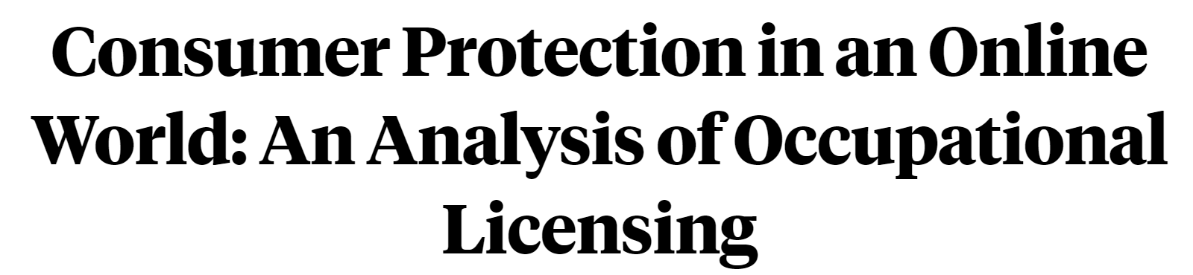
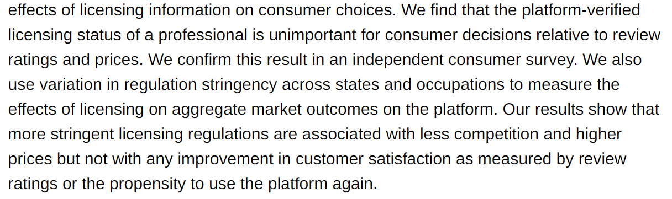
Changing World of Information

Slide 41
Yelp
Anderson & Magruder (2012): studied 148,000 Yelp reviews for 328 restaurants in the San Francisco Bay area.
Typical restaurant earns $2000 per week pre-tax profit. Increasing Yelp score increases profit by approximately $864 per week

Slide 42
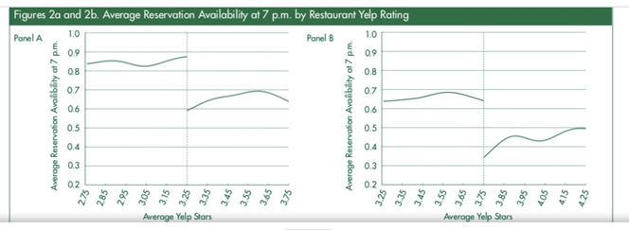
Effects of Yelp Rating

Slide 43
Reputation
Consumer decision-making for credit cards (CFPB Arbitration Report)
First Factor: Acceptance by merchants
Second Factor: Issuer Reputation

Slide 44
Third Party Analysis
Information is costly
Some products can’t be easily verified
Some products require some sophistication or experience to evaluate accurately
Creates a market for reliable third-party verification, especially for big-ticket items

Slide 45

Underwriter’s Laboratory (1894)

Slide 46

Good Housekeeping Seal of Approval (1909)

Slide 47

Consumer Reports (1936)

Slide 48
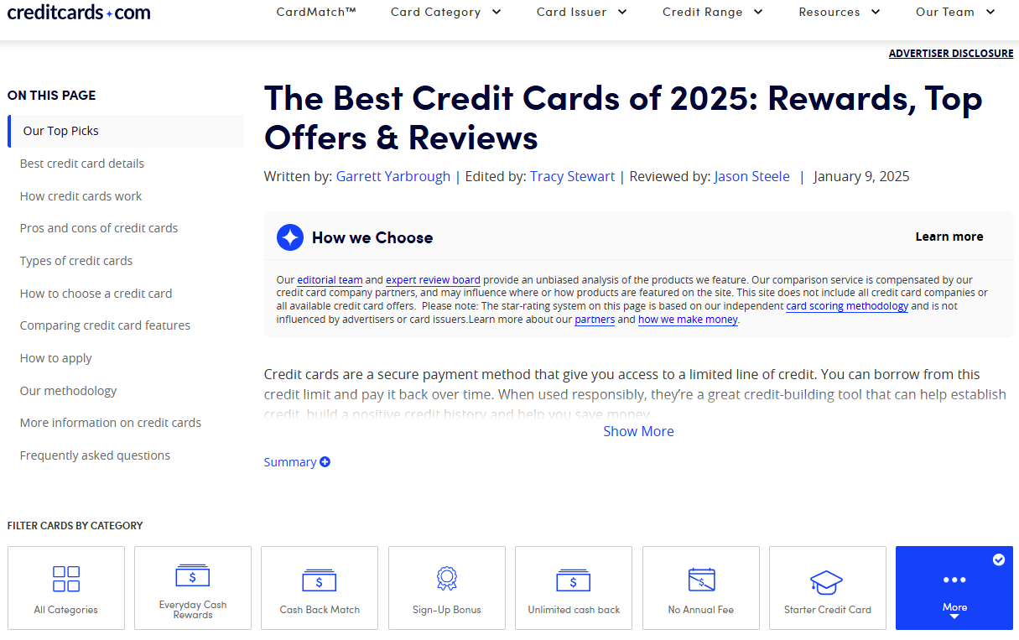
Credit Cards

Slide 49
Market Failure
“Credence Goods”
Information costly
Information Asymmetry
Limits to Repeat Dealing and Reputation
Information Asymmetry: Defects may be difficult to detect
Tourist areas/airports: “Junk fees”
Gains to cheating may > cooperating (Margin Call)
Market Power
Not all market failures will automatically be corrected:

Slide 50
Common Law
Not all market failures will automatically be corrected
Such as nonrepeat customers or atypical fees (“junk fees”)
Courts can create default rules to reduce transaction costs of contracting and protect consumers
Warranties
Tort: Products Liability
Fraud

Slide 51
Common Law “Failure”
Many consumers receive small harms not large enough to sue or hard to detect
Some may complain and get a refund, but others may not notice or complain
Class Actions can potentially aggregate claims
But similar concerning incentive structure—each individual lacks sufficient incentive to sue—applies to monitoring the class action attorney to make sure they are acting in the client’s best interest
Settlements may benefit lawyers more than clients
Excess liability risk may discourage innovation and R&D (Viscusi/Hersch)

Slide 52
Regulation and Public Enforcement
Regulation an alternative to markets and common law
Useful where detection is difficult or many consumers affected: Can calibrate deterrence
But
Changes Slowly
One-Size-Fits-All
Unintended Consequences
Typically should be thought of as a last rather than first resort

Slide 53
When To Regulate
(1) A market failure that cannot be adequately addressed by private ordering or common law at efficient cost
(2) A potential solution exists that is tailored to the market failure—i.e., an information solution for an information problem, not a substantive problem
(3) Marginal benefits intervention > marginal costs (including unintended costs)

Slide 54
How To Regulate: Market-Reinforcing v. Market-Replacing Regulation
Using regulation to make competition and consumer choice work better rather than replacing it with central planning
Example: Truth in Lending Act
FDA Labels

Slide 55
How To Regulate: Market-Reinforcing v. Market-Replacing Regulation
Using regulation to make competition and consumer choice work better rather than replacing it with central planning
Treat Institutions as Complements
Example: Truth in Lending Act
Increased consumer understanding of relevant loan terms
Increased competition by making comparison shopping easier
But later became more complicated
FDA Labels

Slide 56
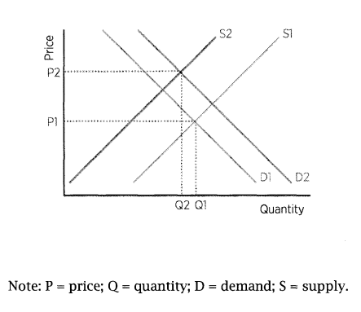
Goal of Consumer Finance Regulation
Maximize Welfare of Consumers, Industry, and Economy
Move beyond the “more v less regulation” binary
Example: Debt Collection

Slide 57
Make Sure that Regulation Fits the Problems
Consumer lending: substantive regulation v. disclosure regulation
Don’t try to fix substantive concerns with disclosure regulation and don’t try to use disclosure to change substantive behavior
“Normative Disclosure”

Slide 58
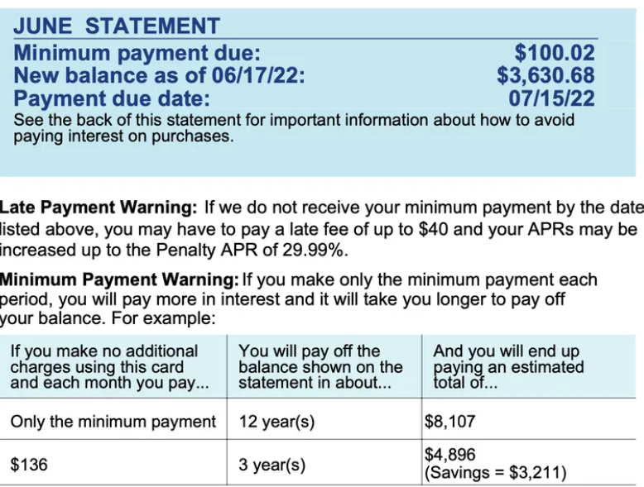
Credit Card “Minimum Payment Warning”
Relevant to 4% of consumers
Actually increased the number of people making only minimum payments

Slide 59
Markets Where Contracting Impossible or High Transaction Costs and Markets Imperfect
Debt Collection: Contracting for your own collector
Credit Reporting, Mortgage Servicing
Technology: Telephone

Slide 60
Federalism: Who Should Regulate?
Why growth of federal regulation?
Interstate commerce:
Department Stores
Marquette
Technology: Communications and Long-Distance Phone
Debt Collection

Slide 61
Wobbly 3-Legged Stool
Federalism Gone Wild: Federalism and Cost Externalization vs Interjurisdictional Competition
State laws that regulate interstate commerce and protect in-state interest groups
“Little FTC Acts”
Loans Made Elsewhere
Common Law Gone Wild: Mass Torts, Class Actions
Preemption and Dormant Commerce Clause: Federal Retrenchment

Slide 62
Cycles of Consumer Credit Regulation: Summary
19th Century and Before: Usury ceilings
Early 20th Century: Urban industrial economy with wage labor/unemployment
Deregulation: Russell-Sage Foundation and Uniform Small Loan Law
The Great Depression and the Response
1960s & 70s: Return of loan sharks, growing importance of credit and movement toward deregulation and market competition
2008 financial crisis and aftermath spurs new restrictions
Today

Slide 63
Pre-19th Century(“Pre-Modern”)
19th Century and Before: Usury ceilings
Distinction between business and consumer borrowing: “Productive” vs “consumption”
Cyclical theory of economic progress (“eating seed corn”)
Usury ceilings often evaded and not enforced
Western states in US allowed higher interest rates in order to attract capital to the frontier:
Example: National Bank Act prohibited national usury ceiling

Slide 64
First Wave: Early 20th Century
Collision between old rules and new urban wage economy
Early 20th Century: Urban industrial economy with wage labor/unemployment
Creates need for credit for unexpected expenses and income interruptions
Future wages are most valuable asset (not farms)
Unsecured loans to workers can’t be made at prevailing usury ceilings
Creates widespread illegal lending/loan sharks
1911: 35 percent of New York City’s employees owed money to illegal loan sharks
Alan Greenspan: “virtual serfdom”
Consumers need access to credit: Encourage competition in fair and transparent markets rather than usury restrictions to control terms
Deregulation: Russell Sage Foundation and Uniform Small Loan Law
36% Interest

Slide 65
Great Depression and Response
Blamed on “Too Much” Consumer Credit
Theories of Market Failure
Excessive Competition
Inefficiently Small Companies Competing for Bad Risks
Natural Monopoly and Public Utility Theories
Certificate of Convenience and Advantage Requirements
Return of Usury Ceilings
End of Prohibition eliminates organized crime’s major revenue source

Slide 66
Second Wave
Return of loan sharks
Mafia diversifies into loan sharking
1969 Estimate of $10 billion = $69 billion today
Compare to US Payday Loan market (total) = $32 billion
1964 New York State Legislative Committee statement of Senator-elect Robert F. Kennedy recommended “altering the state laws on usury so an insolvent person who needs money for legitimate purposes might borrow it at rates that were not exorbitant.”
Richard Nixon 1968 Presidential Nomination Acceptance Speech (Miami, FL): “I pledge to you that the new Attorney General of the United States will be an active belligerent against the loan sharks and the numbers racketeers that rob the urban poor in our cities.“

Slide 67
Second wave: Rise of National Markets
Development of Interstate Markets
Department Stores
Credit Cards
Mobile Population
Interstate Highway System and Air Travel
Telephones
Early Computers

Slide 68
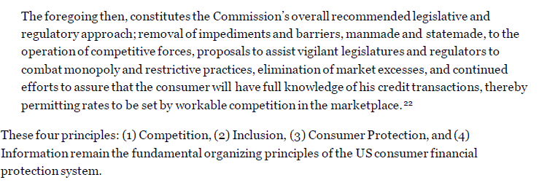
National Commission on Consumer Finance (1972)
Political Dynamics: Johnson to Nixon
Three charges:
“report on the adequacy of existing arrangements to provide consumer credit at reasonable rates”
“the adequacy of existing supervisory and regulatory mechanism to protect against unfair practices and ensure the informed use of consumer credit”
“the desirability of federal chartering or other Federal regulatory measures”
Four Principles:

Slide 69
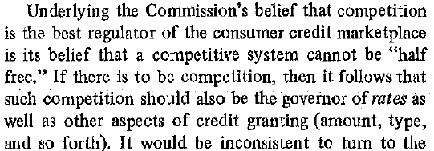
Competition Not Controls
“report on the adequacy of existing arrangements to provide consumer credit at reasonable rates”
Rates and access should be set by competition like any other product
“Unfortunately, the Commission has been able to devise no empirical method for determining who should get credit, how much credit, what kind of credit and at what price.”
“Nor can it say that the price of hamburger or shoes was ‘fair’ at any given time, or that more of either might be better.”

Slide 70
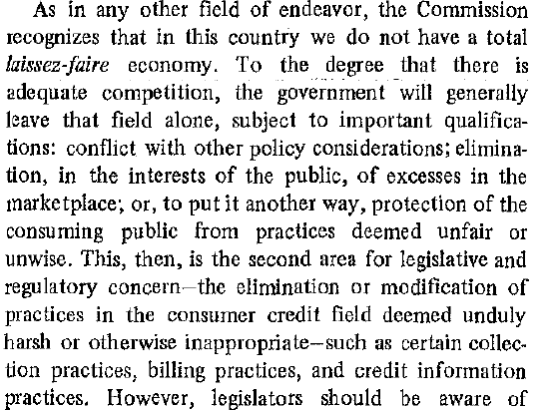
Adequacy of Regulatory Framework
“the adequacy of existing supervisory and regulatory mechanism to protect against unfair practices and ensure the informed use of consumer credit”
Unfair collection practices
Discrimination

Slide 71

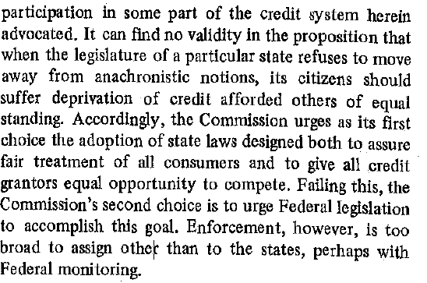
Inclusion and Federal Chartering
“the desirability of federal chartering or other Federal regulatory measures”
Recommends Consumer Protection Agency with Bureau of Consumer Credit or Bureau of Consumer Financial Protection
States need to reform antiquated laws that limit competition
Endorses national chartering of consumer finance companies if states do not eliminate archaic barriers

Slide 72
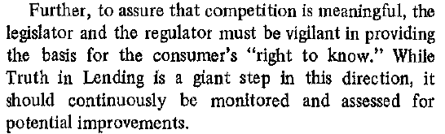
Consumer Information and Choice
Replace existing regulatory framework with one based on Disclosure/information and market competition
Solicited numerous studies on markets, regulation, and Truth in Lending
Senator Paul Douglass and TILA

Slide 73
Deregulation
Gradual elimination of usury ceilings
Marquette National Bank (1978) effectively deregulated credit card interest rates
Deregulation of mortgage usury after S&L crisis: high interest rates to attract capital with price-controls on mortgages
Deregulation of interstate branch banking
Introduction of debit cards in place of checks led to expansion of access to free checking and bank accounts

Slide 74
Third Wave: 2008 Financial Crisis
2008 Financial Crisis
Subprime Mortgages (Not really): Narrative that deregulation led to “predatory lending” that led to foreclosure and mortgage market collapse
Arose during 2008 Presidential Campaign
Dodd-Frank
Created CFPB
The Financial Crisis Inquiry Report: Report written after Dodd-Frank Passed
Development of behavioral economics in place of traditional paternalism

Slide 75
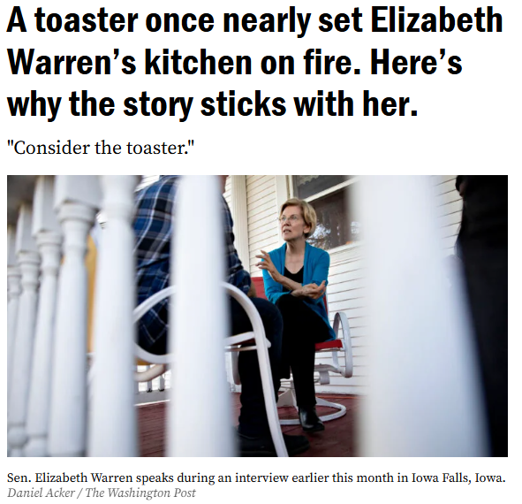
The Origins of CFPB

Slide 76
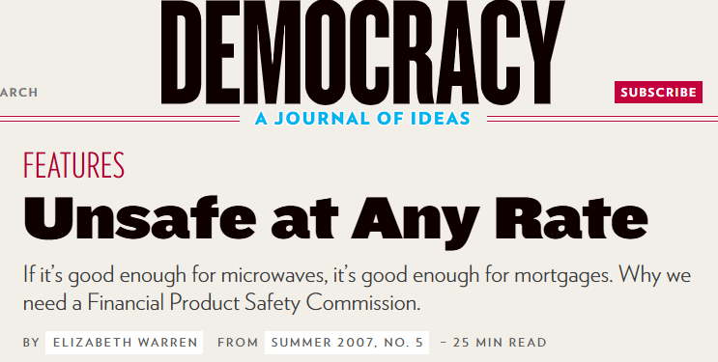
The Idea of the CFPB is Born

Slide 77
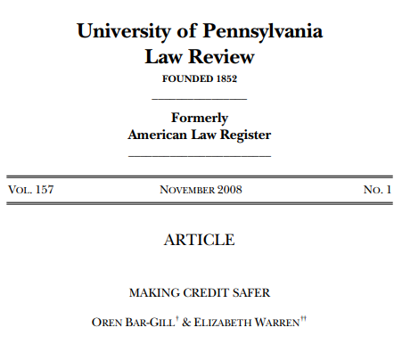
CFPB Meets Behavioral Economics

Slide 78
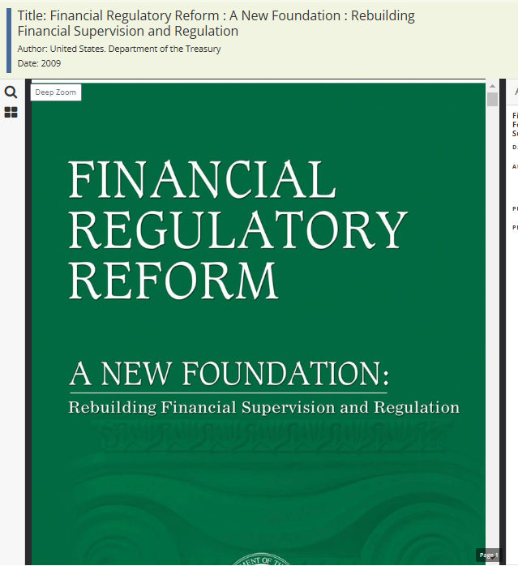
Idea Becomes Proposal: Obama

Slide 79
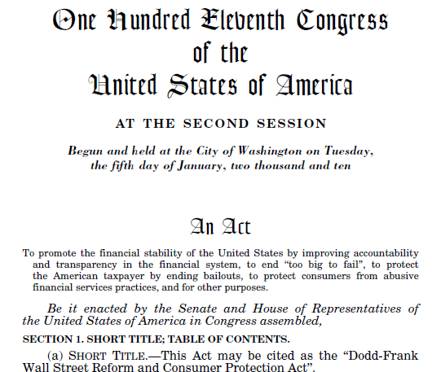
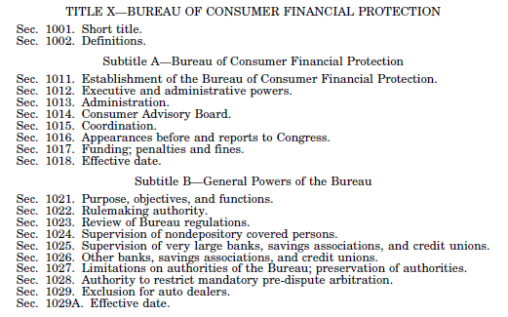
Proposal Becomes Reality

Slide 80
Design of Dodd-Frank
Original Proposal
Final Enactment
Key Feature: Massive Independence
Single Director removable only “for cause”
Budget: Cap of 12% of Fed’s operating expenses ($883m for 2025)
Paid from “combined earnings of the Federal Reserve System”
Concern of Agency Capture
Political Hotbox Since Creation
Filibuster and Cordray Recess
Trump I: Mick Mulvaney and Kathy Kraninger
Biden: Rohit Chopra
Trump II: ?
Director
Legislative Reform

Slide 81
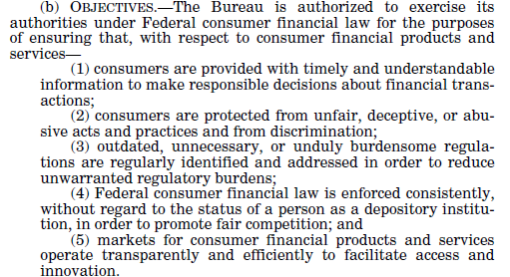
Dodd-Frank and CFPB

Slide 82
CFPB Authorities
18 “enumerated laws” (Levitin p. 114-115)
“Unfair, Deceptive, or Abusive Acts or Practices”
“Abusive” is novel term
“Covered persons” and “service providers”

Slide 83
Litigation Over CFPB’s Novel Structure
Noel Canning: Recess Appointment
Seila Law: Removal of Director by President
CFPB v. CFSA: Appropriations
Current litigation over Trump Administration’s efforts to effectively shut down the agency
Elon Must: “CFPB RIP” then 2nd DOGE Agency (USAID first)
One Big Beautiful Bill: reduced cap on Fed from 12% to 6.5% ($446 mil)
Trump Admin argues that “combined earnings”=“profits” and that Fed has actually had losses (negative profits) the past several years
OLC supports this interpretation
Acting Director Vought said in December he was prohibited from receiving funds from Fed
DC District Court enjoins and Vought relented and asked for funds

Slide 84
CFPB Regulatory Tools
Rulemaking
Enforcement
Supervision
Education
Research

Slide 85
CFPB History
Cordray: Regulation by Enforcement
Kraninger: Retrenchment and stasis
Chopra: Regulation by supervision, guidance, public pressure
Today
Enforcement transferred to DOJ
Many enforcement actions dropped or vacated
Supervision largely dormant
Most rulemaking repeal or amendment to old rules

